Slide 1


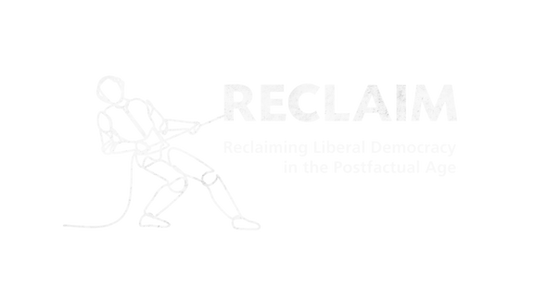

RECLAIM Toolkit for Media Literacy
Prepared By :
Ricardo Castellini da Silva

Slide 2
SESSION 5
“Critical Thinking for Democracy: Harnessing the Power of Media Literacy​”

Slide 3
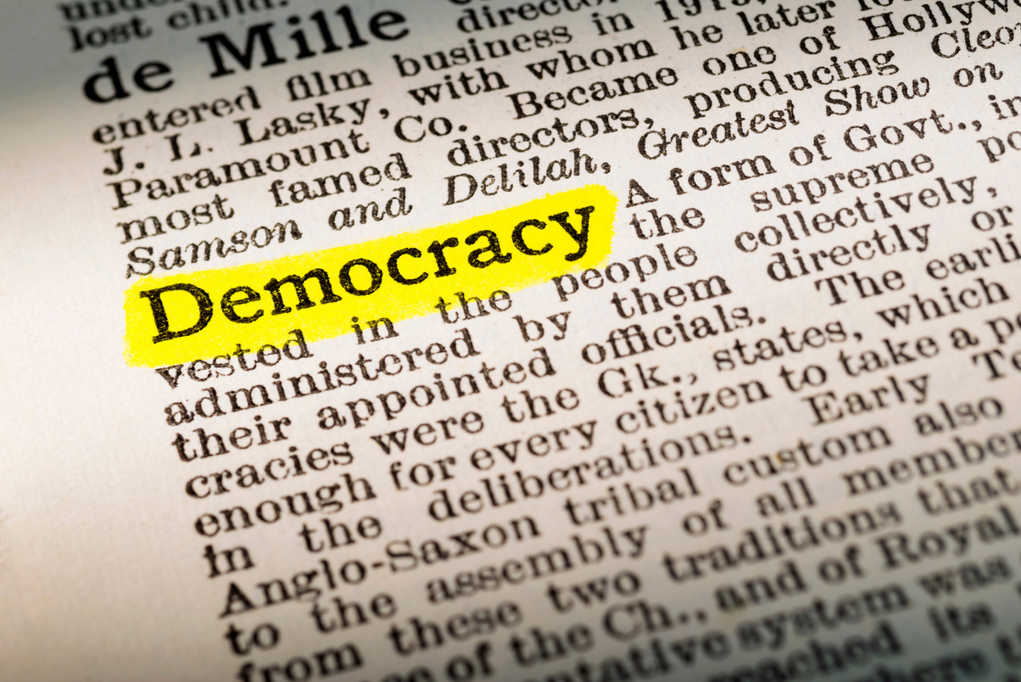
Media Literacy in the Post-Truth Era:
Tackling Disinformation and Protecting Democracy​
Post-Truth: environment where objective facts are less influential in shaping opinions than appeal to emotion and personal beliefs​
​
Democracy’s foundation: informed citizenry making well-informed and reasoned decisions based on shared facts ​
​
Current threat: erosion of a shared reality that undermines democratic processes and institutions​
​
Media literacy: knowledge and skills needed to navigate increasingly complex information landscape

Slide 4
Media Literacy in the Post-Truth Era:
Tackling Disinformation and Protecting Democracy​
Populist Communication Strategies​
Oversimplification: complex issues reduced to binary, good-versus-evil narratives​
​
Emotional appeals: fear, anger, and resentment mobilised instead of factual discussion​
​
Us vs. Them: narratives that see opposition as enemy and undermine institutional credibility​
​
‘Alternative facts’: production of parallel information ecosystems that reject expert knowledge and mainstream sources

Slide 5
Media Literacy in the Post-Truth Era:
Tackling Disinformation and Protecting Democracy​
The Democratic Stakes​
Electoral integrity: misinformed voters may make decisions based on false or misleading premises​
​
Institutional trust: declining faith in expert knowledge and democratic institutions (judiciary, elections, media, universities, science etc.)​
​
Social unity: Radical polarisation disrupts dialogue as the shared factual ground disappears

Slide 6
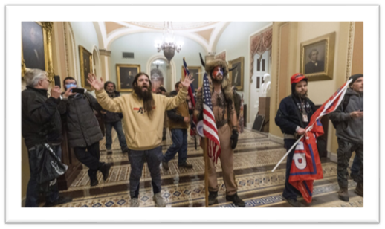
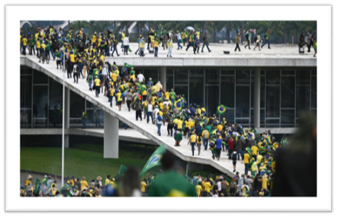
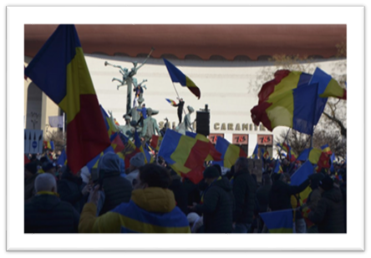
Media Literacy in the Post-Truth Era:
Tackling Disinformation and Protecting Democracy​

Slide 7
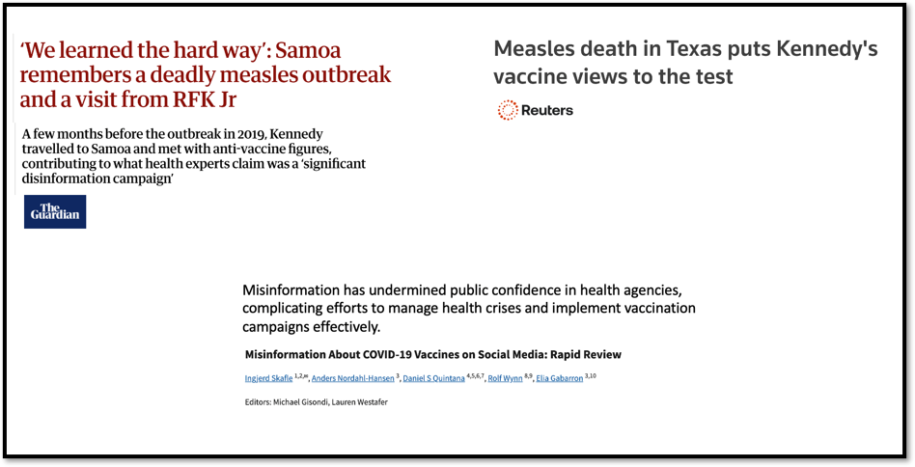
Media Literacy in the Post-Truth Era:
Tackling Disinformation and Protecting Democracy​

Slide 8
Media Literacy in the Post-Truth Era:
Tackling Disinformation and Protecting Democracy​
The Media Ecosystem​
Platform dynamics: understanding the attention economy and how algorithms shape our online consumption and behaviour ​
​
Media ownership: awareness of concentration and political connections ​
​
Information lifecycle: how false and misleading stories emerge, spread, and evolve across platforms

Slide 9
Media Literacy in the Post-Truth Era:
Tackling Disinformation and Protecting Democracy​
Core Media Literacy Skills​
Source evaluation: assessing credibility, motivation, and evidence quality ​
​
Content analysis: identifying bias, emotional manipulation, and logical fallacies ​
​
Fact-checking: checking information across multiple reliable sources (e.g., lateral reading)

Slide 10
Media Literacy in the Post-Truth Era:
Tackling Disinformation and Protecting Democracy​
Understanding Ourselves​
Bias: being aware of our bias, specially confirmation bias​
​
Online behaviour: understanding how the digital ecosystem influences the way we behave online, including our attention and cognitive capacity

Slide 11
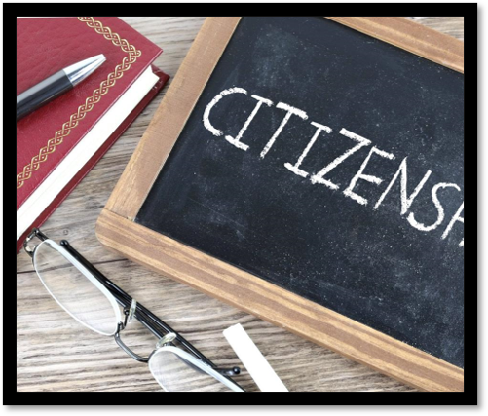
Civic Media Literacy​
It promotes the integration of media literacy with active civic participation. This approach emphasises not only the critical consumption of media but also the intentional use of media to engage in civic life and contribute to the common good.​

Slide 12
Civic Media Literacy​
Agency: empowering individuals to recognize their capacity to contribute to their societies through media engagement.​​
​
Caring: promoting empathy and concern for others, motivating civic actions that benefit communities.​​
​
Critical consciousness: encouraging awareness of social, political, and economic contexts to understand and challenge systemic issues.​
​​
Persistence: developing resilience and sustained commitment to civic initiatives, even in the face of challenges.​​
​
Emancipation: promoting liberation from oppressive structures through informed and purposeful media use.

Slide 13
Civic Media Literacy​
Collective immunity: building societal resistance to manipulation and disinformation ​
​
Institutional support: protecting independent journalism democratic institutions ​
​
Dialogue: creating healthy digital spaces for constructive engagement across divides ​
​
Life-long learning: building citizen capacity rather than just fact-checking ​
​
Democratic culture: promoting values of evidence, reasoned debate, diversity, equity and pluralism

Slide 14
Practical Activity
Designing a media literacy initiative for democratic resilience​
​You will design either:​
​
A media literacy educational activity targeting a specific audience​
​
OR​
​
A policy proposal aimed at strengthening media literacy to counter disinformation and support democratic processes.

Slide 15
Practical Activity
Suggested Structure:​
​1. Define the Problem/Context​
Choose a country, region, or political context (e.g., election season, polarized society, vulnerable groups, warzone).​
Explain the key disinformation risks or media literacy gaps threatening democratic resilience.​
​
2. Set Objectives ​
Examples:​
Increase citizens’ ability to spot misinformation in political campaigns.​
Train young voters to critically analyse news sources.​
Provide policymakers with tools to regulate algorithmic transparency.

Slide 16
Practical Activity
Suggested Structure:​
​3. Develop the activity or policy​
​For a learning activity​
Target audience: students, voters, civil servants, journalists, etc.​
Format: Workshop, game, campaign, social media challenge, simulation.​
Knowledge/skills focus: fact-checking, recognizing bias, algorithmic awareness​
Implementation plan: duration, resources, pedagogical approaches (theoretical input, group work, discussions etc).​
​
For a policy proposal:​
Scope: national, regional, global, education policy, tech regulation​
Proposed measures: mandatory media literacy curricula, social media platform accountability, funding fact-checking projects​
Stakeholders: media, government, NGOs, platforms​
Potential risks & benefits

Slide 17
Practical Activity
Suggested Structure:​
​4. Media Literacy Principles:​
​How does your proposal address the disinformation problem?​
How does it protect freedom of expression and democratic values?​
What media literacy knowledge and skills does it build?​
How does it contribute to democratic resilience?

Slide 18
About RECLAIM
RECLAIM (Reclaiming Liberal Democracy in the Post-Factual Age) is a Horizon Europe project on Reclaiming Liberal Democracy in a Post-Truth era. In recent years there has been a rise in what the experts call “post truth politics”, which manipulates facts and emotions. The project tries to understand how this phenomenon is affecting the future of democracy in Europe, and more importantly, what we can do about it.
About TEPSA
The Trans European Policy Studies Association (TEPSA) was established in 1974 as the first transnational research network in the field of EU affairs. It comprises leading research institutes throughout Europe, with an office in Brussels. Its aim is to provide high-quality research on European integration to stimulate discussion on policies and political options for Europe. This is achieved by the interaction between the European and national institutions as well as the academic and research community. TEPSA is active on a wide range of research topics, focusing on differentiated integration, the EU's external relations, democratic participation and citizens' engagement.

