Slide 1
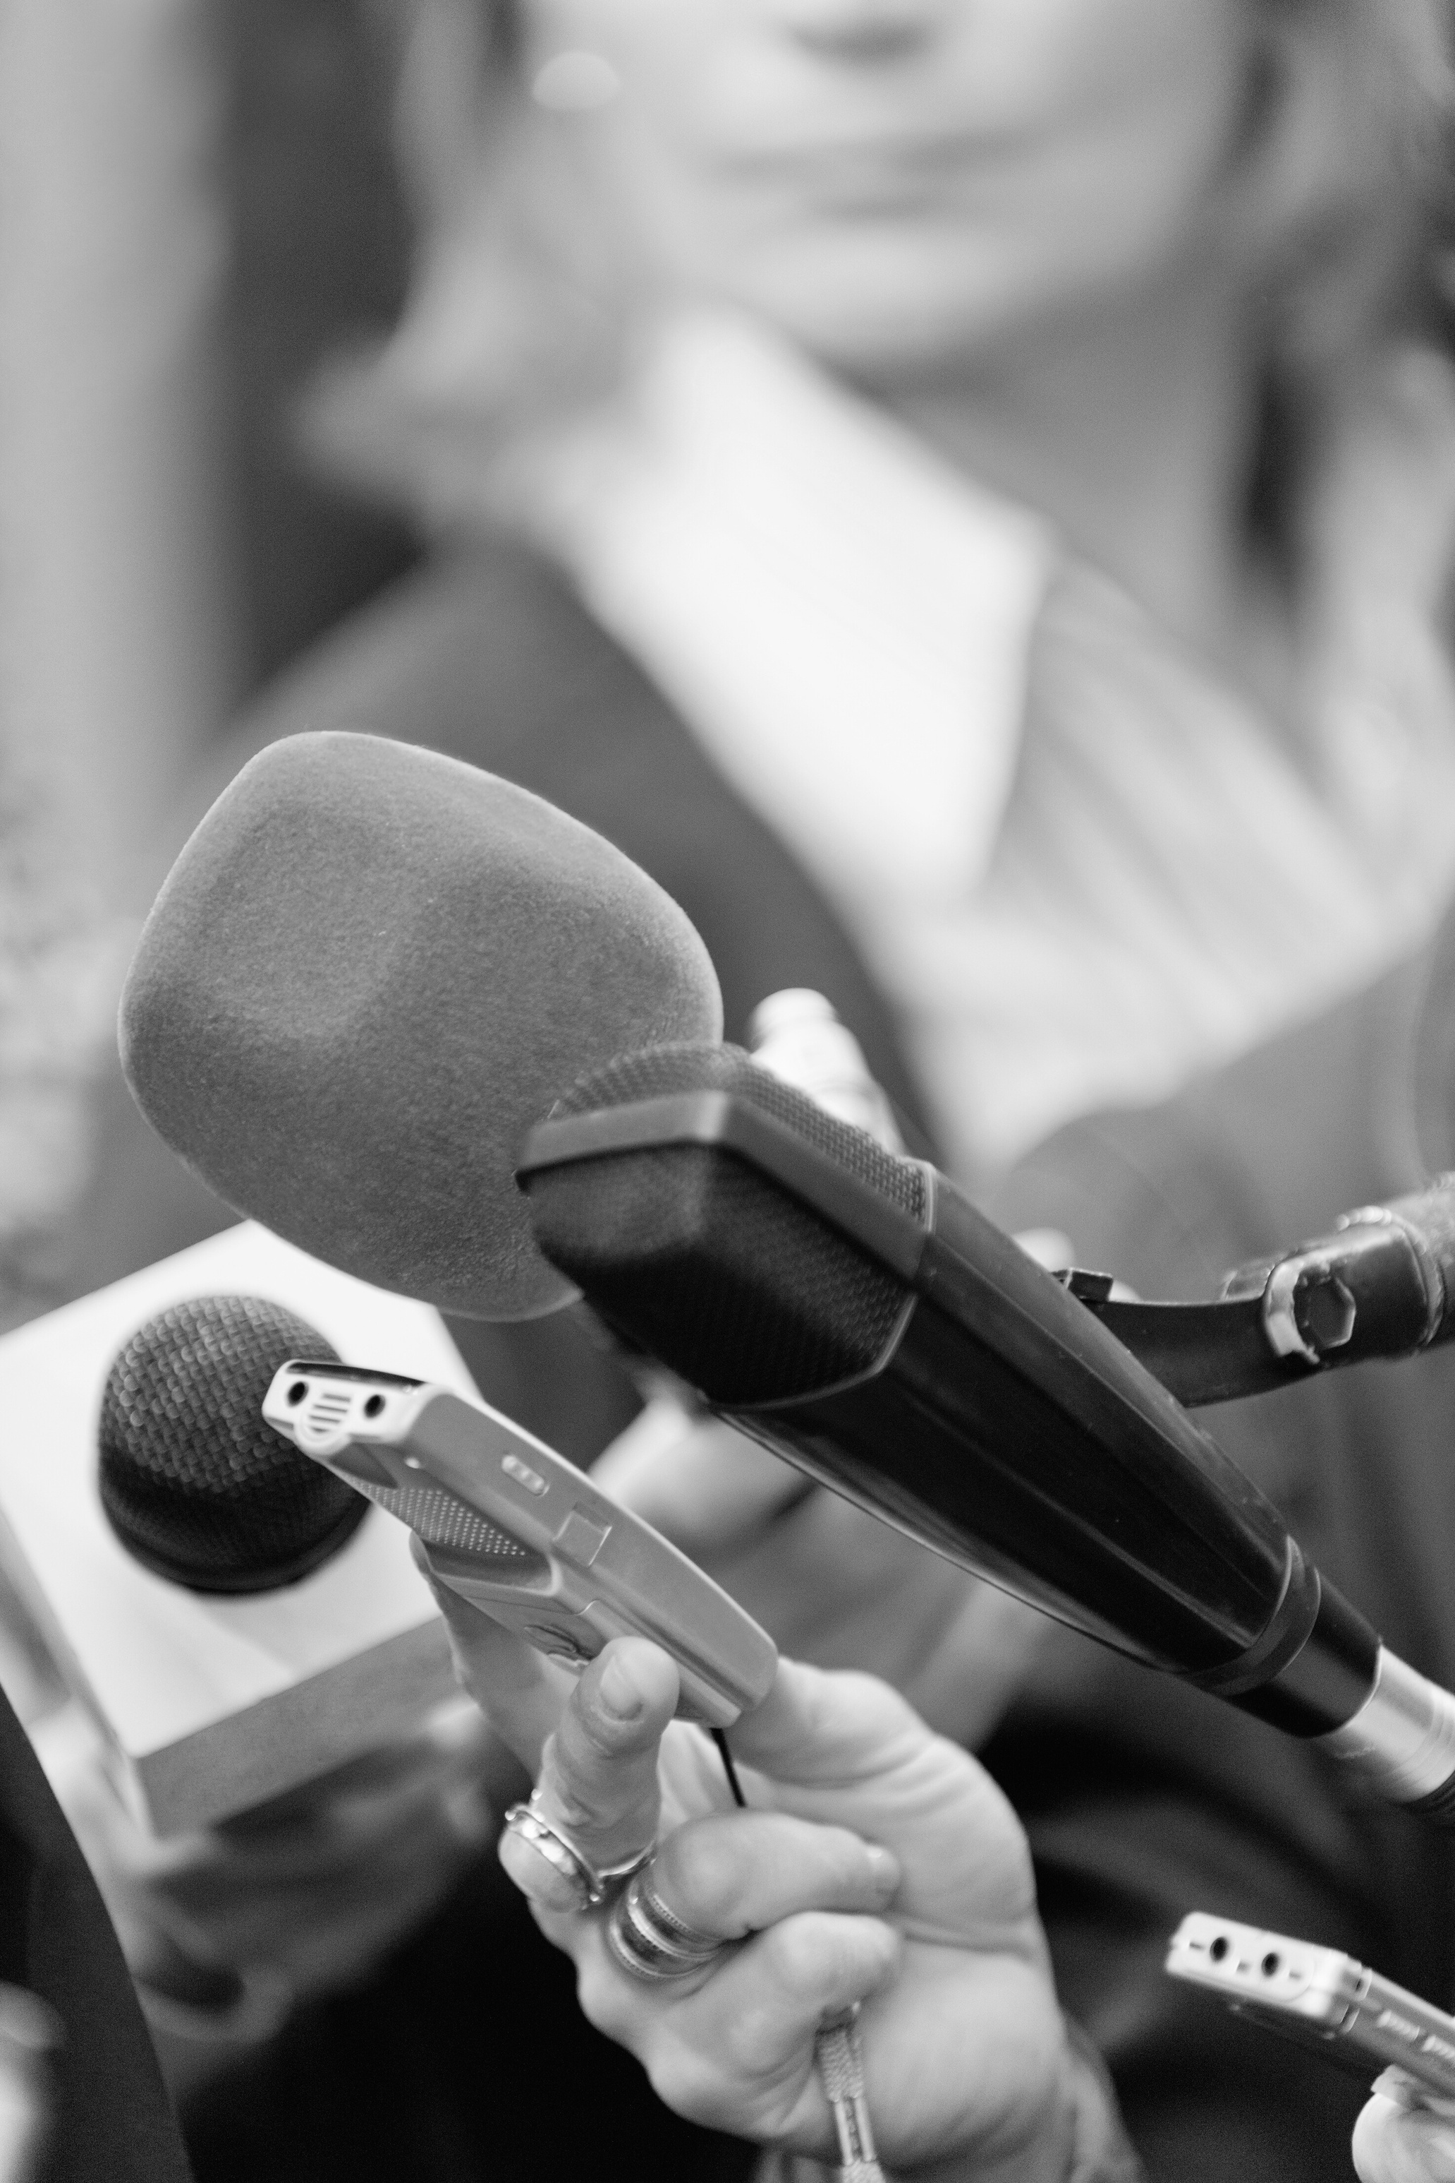

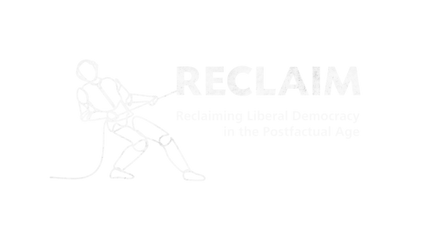

RECLAIM Toolkit for Media Literacy
Prepared By :
Ricardo Castellini da Silva

Slide 2
SESSION 4
“Whom should we Trust? Our Minds and the Importance of Reliable Sources​”

Slide 3
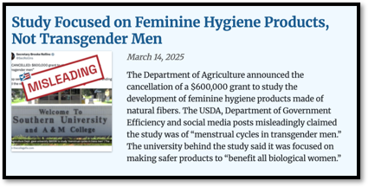
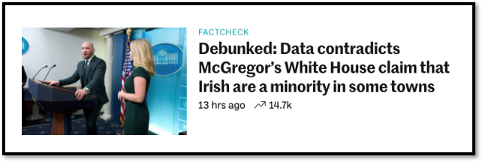
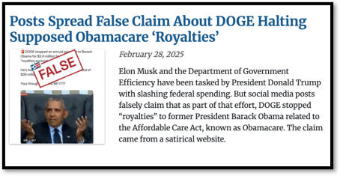
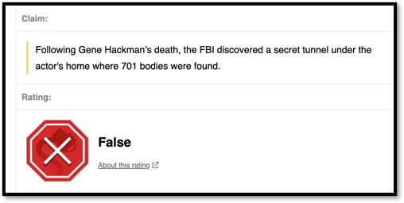
Why do People Believe in Disinformation and Conspiracy Theories?​

Slide 4
Why do People Believe in Disinformation and Conspiracy Theories?​
Evidence suggests that the reason why people believe in false and misleading information is completely contextual, dependent on many different factors. ​
​
And remember: all of us are susceptible to disinformation.

Slide 5
Why do People Believe in Disinformation and Conspiracy Theories?​
Attention​
We have seen that attention-grabbing features, such as infinite scroll or sensational headlines, can divert our focus from critical evaluation. Poor attention or focus can lead to superficial information processing, increasing susceptibility to false or misleading information.​​

Slide 6
Why do People Believe in Disinformation and Conspiracy Theories?​
Cognitive Capacity​
It refers to our ability to process information, reason, and make decisions. Many factors can alter our ability to reason and make decisions, such as fatigue, stress, anxiety etc. These factors can reduce our capacity of analytical thinking, making us more susceptible to false or misleading information. ​

Slide 7
Why do People Believe in Disinformation and Conspiracy Theories?​
Knowledge Repertoire​
This refers to the amount of information and understanding we have about a given subject. Lack of accurate knowledge can make us more vulnerable to accepting false or misleading information.​

Slide 8
Why do People Believe in Disinformation and Conspiracy Theories?​
Repetition and the Illusory Truth Effect​
This refers to the fact that if we are repeatedly expose to false or misleading information, we are far more likely to believe it is true. Furthermore, repeated information is generally perceived as more truthful than new information.​

Slide 9
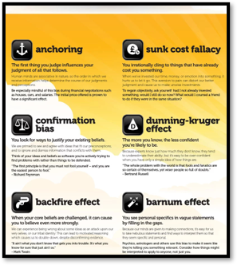
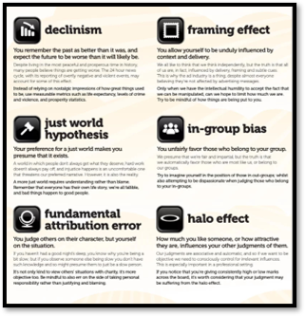
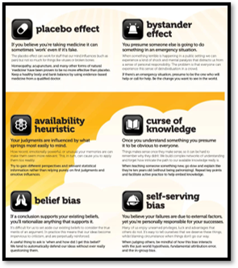
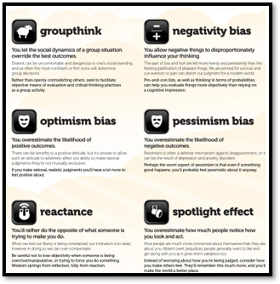
Why do People Believe in Disinformation and Conspiracy Theories?​
Biases​
Studies suggest that we have more than 170 cognitive biases. ​
https://www.yourbias.is/

Slide 10
Why do People Believe in Disinformation and Conspiracy Theories?​
Biases​
Confirmation Bias: The tendency to search for, accept or favour information that aligns with or confirms our pre-existing beliefs. It leads people to uncritically accept false or misleading information that supports our viewpoints, reinforcing false beliefs. ​
​
Motivated Reasoning: The tendency to immediately accept new information that conforms to with our worldview and critically analyse information which doesn’t.​
​
Those biases lead people to uncritically accept false or misleading information that supports our viewpoints, reinforcing false beliefs.

Slide 11
Conspiracy Theories
Psychological Factors​
The illusion of control: conspiracy theories provide easy explanation for complex problems or events. Understanding the "hidden causes" gives a sense of predictability in a chaotic environment.​
​
Psychological relief: simple and more palatable narratives reduce anxiety by providing clear explanations​
​
Pattern recognition: our brains evolved to find patterns in nature, and sometimes we see them where they don’t exist.

Slide 12
Conspiracy Theories
Social Factors​
Group identity: conspiracy theories create strong personal connections in like-minded communities​
​
Social validation: believing in the same stories creates sense of belonging and purpose ​
​
Status and exclusivity: the idea only you and a few other people know the ‘hidden truth" creates a feeling of superiority

Slide 13
Conspiracy Theories
Technological Factors​
Filter bubbles: content driven by algorithms creates ‘digital bubbles’ that reinforce and validate information ​
​
Lack of trust: declining respect for and faith in traditional institutions and media organizations, especially news media​
​
Virality instead of accuracy: false or misleading information tends to spread faster than good-quality information

Slide 14
Conspiracy Theories
How to talk to people who believe in conspiracy theories?​
Avoid mocking or confrontation: simply challenging people’s beliefs will not change their minds. On the contrary, this might reinforce their commitment to those beliefs (backfire effect). ​
​
Open mind: approach the conversation with an open mind, listen to them, and identify shared values to build a good connection. ​
​
Slow counter-argument: try your best to understand their viewpoints, ask about possible flaws or contradictions in their argument, and slowly introduce different perspectives. ​
​
Critically discuss sources: suggest exploring a variety of information sources, and also applying acritical approach to all sources of information, including those that support their beliefs.

Slide 15
Pre-bunking
What if we could recognise false information before it influences us?​

Slide 16
Pre-bunking
This approach is based on inoculation theory, which suggests that, just like vaccines, pre-exposure to a diluted dose of disinformation can stimulate mental defences, enabling individuals to recognise and resist false information when confronted with it later.​
​
Educational interventions using this approach aim to teach people to recognise common manipulation tactics and rhetorical techniques before encountering them. They focus on the methods of deception rather than just specific content.

Slide 17
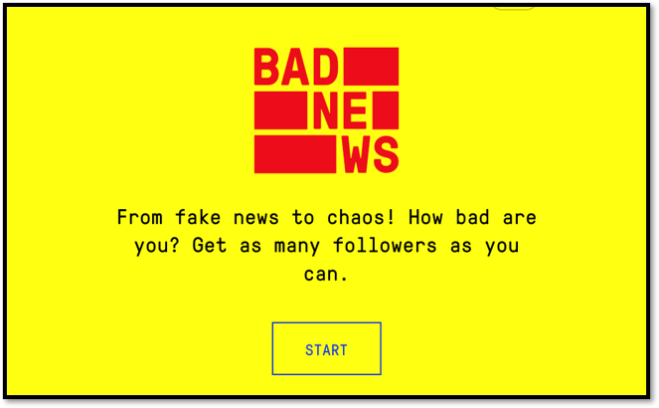
Pre-bunking
https://www.getbadnews.com/en​

Slide 18




Who Should we Trust?​
In a world full of false and misleading information, who should we trust? ​

Slide 19

Who Should we Trust?​
Can we trust any source 100%? Probably not. But some aim for truth - others for attention.​
Imperfection vs. Reliability: professional journalism as a more trustworthy model.​

Slide 20
Who Should we Trust?​
Good-quality journalism is an important pillar of democracies.​
Journalists work as curators of truth. Their work involves asking hard questions, verifying facts, and explaining complex issues.​

Slide 21
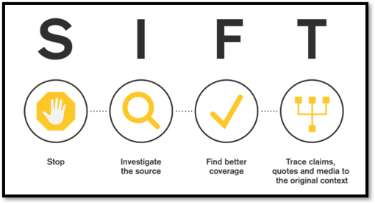
Who Should we Trust?​
We must develop habits of critical thinking, transparency-seeking, healthy scepticism, and curiosity. ​
And, when we are not sure about who we should trust, we must act like investigators.​
by Mike Caulfield

Slide 22
Practical Activity​
Designing a media literacy initiative for democratic resilience​
​You will design either:​
​
A media literacy educational activity targeting a specific audience​
​
OR​
​
A policy proposal aimed at strengthening media literacy to counter disinformation and support democratic processes.

Slide 23
Practical Activity​
Source Comparison:
​Which source would you trust most - and why?​

Slide 24
About RECLAIM
RECLAIM (Reclaiming Liberal Democracy in the Post-Factual Age) is a Horizon Europe project on Reclaiming Liberal Democracy in a Post-Truth era. In recent years there has been a rise in what the experts call “post truth politics”, which manipulates facts and emotions. The project tries to understand how this phenomenon is affecting the future of democracy in Europe, and more importantly, what we can do about it.
About TEPSA
The Trans European Policy Studies Association (TEPSA) was established in 1974 as the first transnational research network in the field of EU affairs. It comprises leading research institutes throughout Europe, with an office in Brussels. Its aim is to provide high-quality research on European integration to stimulate discussion on policies and political options for Europe. This is achieved by the interaction between the European and national institutions as well as the academic and research community. TEPSA is active on a wide range of research topics, focusing on differentiated integration, the EU's external relations, democratic participation and citizens' engagement.

