Slide 1




RECLAIM Toolkit for Media Literacy
Prepared By :
Ricardo Castellini da Silva

Slide 2
SESSION 3
“Media Literacy in the Digital Age​”

Slide 3

Only 22 Years Ago…​
David Buckingham is one of the leading international experts in the field - he has more than twenty years' experience in media education as a teacher and researcher.​
This book takes account of recent changes both in the media and in young people's lives and provides an accessible and clear set of principles on which the media curriculum should be based.​
​
Introduces the aims and methods of media education or 'media literacy'.

Slide 4



Up to Now…​
Video​
Website​
Photo​

Slide 5

In the Future...

Slide 6
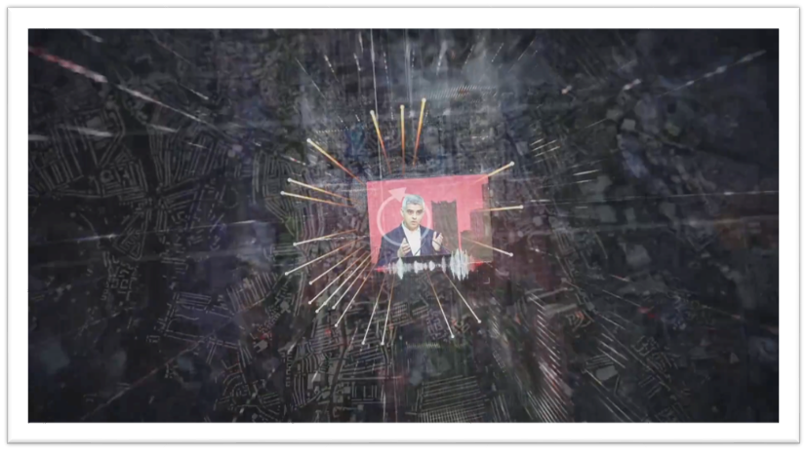
The Fake Mayor By Karim Amer​

Slide 7
Discussion​
Media Literacy in the Digital Age​
​
Given the emergence of AI and new digital media technologies, in your opinion, how does the Digital Ecosystem change the Media Literacy field? What are the new knowledge, skills and attitudes required to deal with media in the digital age?​
​
Remembering David Buckingham…

Slide 8
Discussion​
How do you think algorithms decide what content we see on social media, streaming platforms, and search engines?​
In what ways do digital platforms use personal data to personalise content or target us with ads and recommendations?​
How can persuasive design features (like autoplay, infinite scroll, notifications) influence our media consumption and behaviour online?​
What are some examples of misinformation or disinformation that were amplified by algorithmic systems? What made them go viral?​
How do recommendation algorithms create filter bubbles or echo chambers? What are the consequences for public opinion and democracy?​
How can we critically analyse a platform’s design and affordances (what it allows users to do) to understand its influence on how we consume information?

Slide 9
Discussion​
What ethical challenges arise from the collection and use of personal data by digital platforms and AI systems?​
What strategies can individuals use to resist manipulation, fact-check information, and make informed decisions in the digital media ecosystem?​
In your opinion, the digital media landscape helps or hinders populist figures to achieve their ideas? What are the possible consequences of this for democracies around the world?​
One of the goals of Critical Media Literacy is the emancipation of the individual. But if algorithms are increasingly making decisions for us, how much of our autonomy is real? What happens to free will when AI knows our desires better than we do?

Slide 10

Media Literacy in the Digital Age

Slide 11
Media Literacy in the Digital Age
Some basic definitions before we move on…​

Slide 12

Artificial Intelligence​
Artificial intelligence (AI) is the umbrella concept that refers to computer systems capable of performing complex tasks that typically require human intelligence. ​
​
These systems can interpret external data, learn from it, and adapt to achieve specific goals. AI encompasses a variety of technologies, such as machine learning, deep learning, and natural language processing, which aim to create expert systems to make predictions or classifications based on input data.

Slide 13
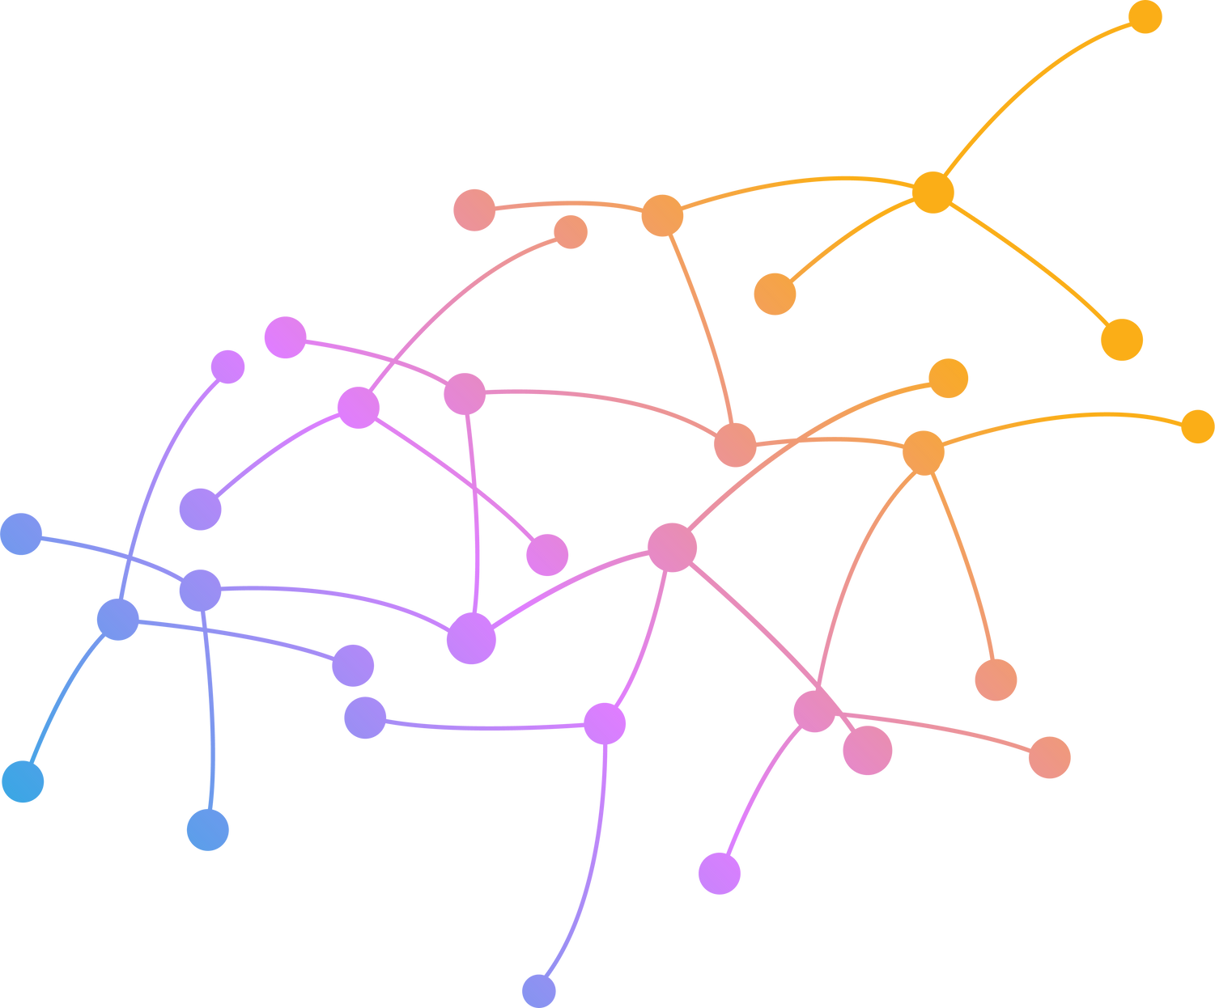
Algorithms​
An algorithm is a step-by-step procedure or set of rules designed to perform a specific task or solve a problem. They are essentially the instructions that systems follow to process data and produce outputs.​
​
​Artificial intelligence and algorithms are intrinsically linked, as algorithms form the foundational building blocks of AI systems. ​
​
AI uses complex algorithms to simulate aspects of human thinking, such as reasoning, decision-making and problem-solving.

Slide 14

Machine Learning​
Machine learning (ML) is a branch or subfield of AI that focuses on developing algorithms that enable systems to learn from and make decisions based on data without being explicitly programmed for each task. ​
​
This process involves identifying patterns within data, which can then be utilised for predictions, classifications, or decision-making.

Slide 15
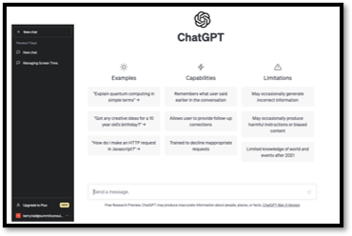

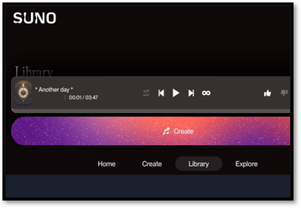
Generative AI​
Generative AI encompasses AI systems that can create new content, such as text, images, or music, based on the data they were trained on. ​

Slide 16

Attention Economy​
It refers to a system where human attention is treated as a valuable commodity. In this scenario, various institutions, including media organisations and digital platforms, compete to capture and retain people’s attention, which is then turned into revenue and influence.​

Slide 17
Attention Economy​
These organisations need to grab our attention because of our data. But why?​

Slide 18
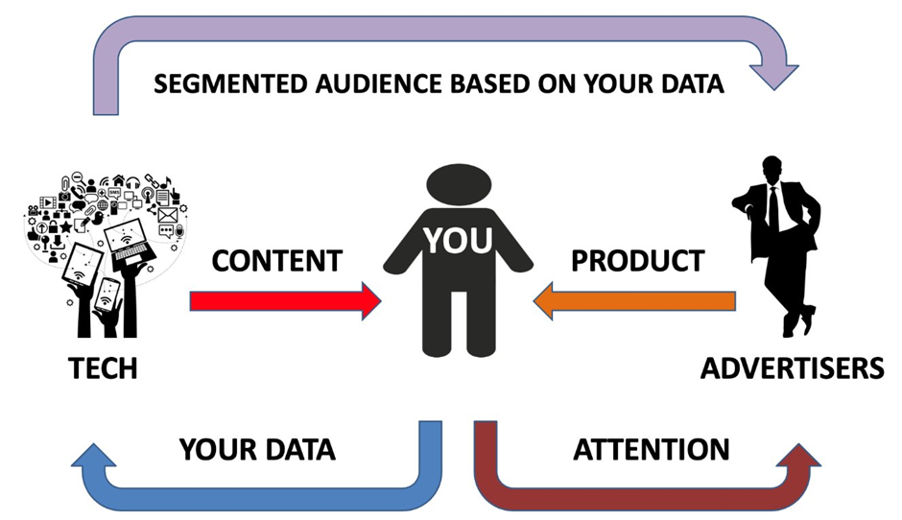
Attention Economy​

Slide 19

Surveillance Capitalism​
Surveillance capitalism refers to the practice of collecting people’s data based on their online behaviour, which allow companies and organisations to understand our preferences, modify our behaviours, and predict our future actions. This is done primarily to generate revenue and market control.​

Slide 20
The Digital Media Ecosystem​
Attention-based business model: advertising revenue tied directly to user engagement.​
​
Easy and cheap content creation: potentially, anyone can produce and spread digital content.​
​
Platform dominance: concentration of people’s data in a few major platforms (Google, Amazon, Meta, Netflix etc.)​
​
Metrics based on engagement and interaction: views, clicks, shares, and time spent drives decision-making.​
​
Competition intensification: constant dispute for user attention.

Slide 21
The Digital Media Ecosystem​
What are some of the main strategies digital platforms use to grab our attention?​

Slide 22
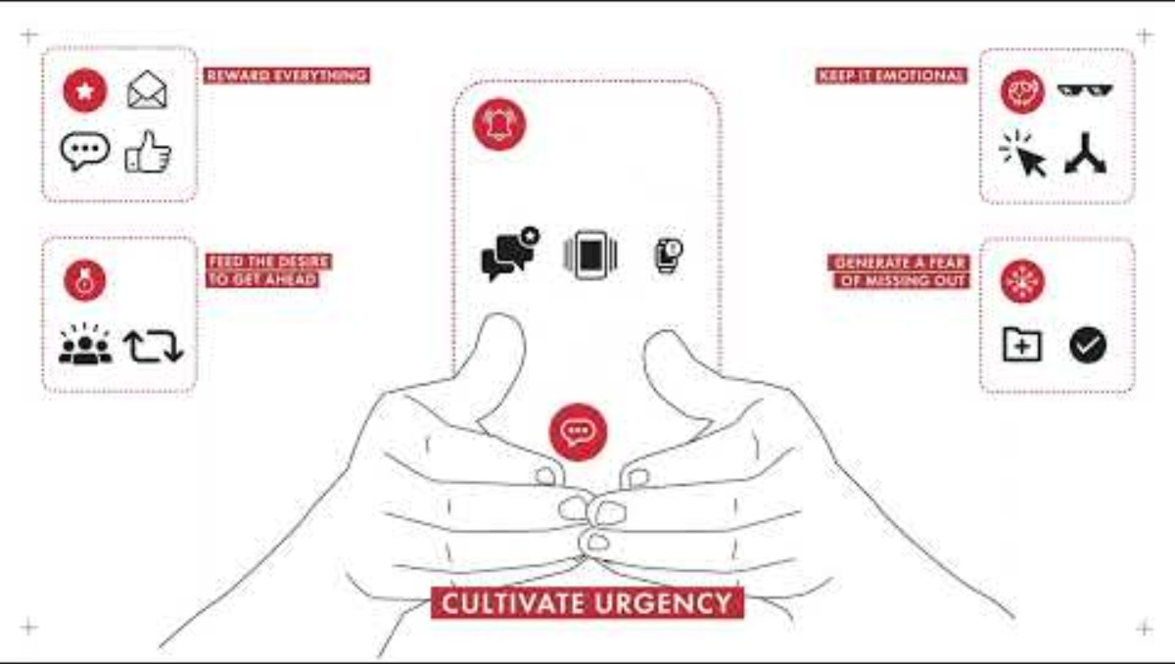
The Digital Media Ecosystem​
Source: Tactical Tech
https://theglassroom.org/en/misinformation-edition​

Slide 23
Quantity over Quality​
Many media organisations and other content creators use a variety of strategies and techniques to persuade users to click on their links, such as eye-catching headlines that evoke curiosity, or the use of sensationalist language that looks shocking and makes people want to learn more by clicking on the link. The goal is to grab your attention, spark your interest, and ultimately drive you to engage with their content.​
​
How does it affect news media and journalism?

Slide 24

Attention Issues​
Amidst this ocean of information,digital platforms and media organisations want to grab your attention.​

Slide 25
Less Attention: Easy Prey for Disinformation​
You are not able to assess the media environment: its features & how it influences the way we engage with information.​
You are not able to evaluate the source of information. And if you don’t know who created a piece of content, you cannot even start the process of assessing its reliability.​
You are not able to check your personal bias, so you cannot assess how your personal preferences may influence the way you understand the content.

Slide 26
Media Literacy
AI AND MEDIA LITERACY​

Slide 27
AI in Everyday Life​
Navigation Apps ​
Google Maps, Waze​
Predict traffic patterns, suggest fastest routes, and estimate arrival times​
​
Online Shopping ​
Amazon, eBay, online retailers​
Recommend products, customise search results, and predict shipping times​
Email Services ​
Gmail, Outlook​
Filter spam, categorise emails, suggest replies, and autocomplete sentences

Slide 28
AI in Everyday Life​
Virtual Personal Assistants​
Siri (Apple), Google Assistant, Alexa (Amazon) ​
Used for setting alarms, answering questions, sending texts, and controlling smart home devices​
Entertainment Platforms ​
Netflix, Spotify, YouTube​
Recommend content based on viewing/listening history and preferences​
Social Media ​
Facebook, Instagram, X​
Curate feeds, suggest connections, and detect potentially harmful content

Slide 29
AI in Everyday Life​
AI and Media Literacy have become increasingly intertwined due to AI's significant influence on media creation, dissemination, and consumption. AI technologies, such as deepfakes and automated journalism, can both enhance and challenge the authenticity of information. ​

Slide 30

AI in Media Literacy​
Decoding Generative Artificial Intelligence with Media and Information Literacy​
https://www.youtube.com/watch?v=4jN0ASk959Y​

Slide 31
Opportunities​
Content Creation and Assistance​
Content creation tools accessible to the public​
New forms of creative expression through generative tools​
Lower barriers to producing high-quality media content​
Information Access​
Overcoming language barriers through translation​
Simplifying intricate and complex data for easier understanding

Slide 32
Opportunities​
Educational Empowerment​
More personalised learning experiences​
Interactive tools that adapt to individual needs​
Critical Analysis Support ​
Assistance to identify patterns in media coverage​
Tools to compare information sources for consistency and bias​
Fact-checking assistance to verify claims

Slide 33
Challenges​
Algorithmic Influence​
Personalisation that creates filter bubbles, limiting the access to diverse viewpoints​
Recommendation systems prioritising engagement over information quality​
Hidden decision-making in what kind of information we see​
Fair Access and Representation ​
Biases in AI systems reflecting historical discriminations​
Uneven global access to AI tools​
Risk of further marginalising underrepresented communities

Slide 34
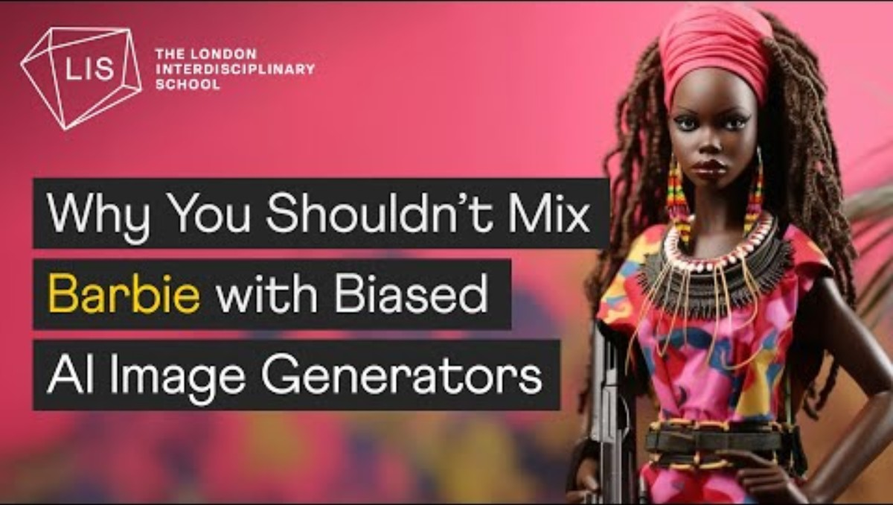
AI and Representation​
How AI Image Generators Make Bias Worse​
https://www.youtube.com/watch?v=L2sQRrf1Cd8​

Slide 35
Challenges​
Privacy and Data Security​
AI-powered media platforms collect vast amounts of user data, raising concerns about surveillance and digital privacy.​
Personalised content recommendations can lead to data exploitation and manipulation.​
Transparency, Authorship and Agency ​
Hidden decision-making in recommendation systems​
Over-reliance on AI-generated content may lead to a decline in original works, including in journalism and the creative industry.​
AI-generated art, music, and writing raise ethical questions about authorship and intellectual property.

Slide 36
Challenges​
Information Quality ​
AI-generated misinformation at unprecedented scale and sophistication​
Deepfakes that appear authentic​
Content that seems credible but contains subtle inaccuracies​
Inadequacy of traditional verification methods​
Authentication Problems​
Difficulty distinguishing AI-generated from human-created content ​
Problems with traditional markers of credibility​
Issues with attribution for remixed or AI-generated content

Slide 37

Deep Fakes​
How to spot deepfakes and AI-generated images​
https://www.youtube.com/watch?v=7akzhpx0EIU​

Slide 38
Addressing the Challenges​
AI LITERACY…​
ALGO-LITERACY…​
DATA LITERACY…​

Slide 39
About RECLAIM
RECLAIM (Reclaiming Liberal Democracy in the Post-Factual Age) is a Horizon Europe project on Reclaiming Liberal Democracy in a Post-Truth era. In recent years there has been a rise in what the experts call “post truth politics”, which manipulates facts and emotions. The project tries to understand how this phenomenon is affecting the future of democracy in Europe, and more importantly, what we can do about it.
About TEPSA
The Trans European Policy Studies Association (TEPSA) was established in 1974 as the first transnational research network in the field of EU affairs. It comprises leading research institutes throughout Europe, with an office in Brussels. Its aim is to provide high-quality research on European integration to stimulate discussion on policies and political options for Europe. This is achieved by the interaction between the European and national institutions as well as the academic and research community. TEPSA is active on a wide range of research topics, focusing on differentiated integration, the EU's external relations, democratic participation and citizens' engagement.

