Slide 1
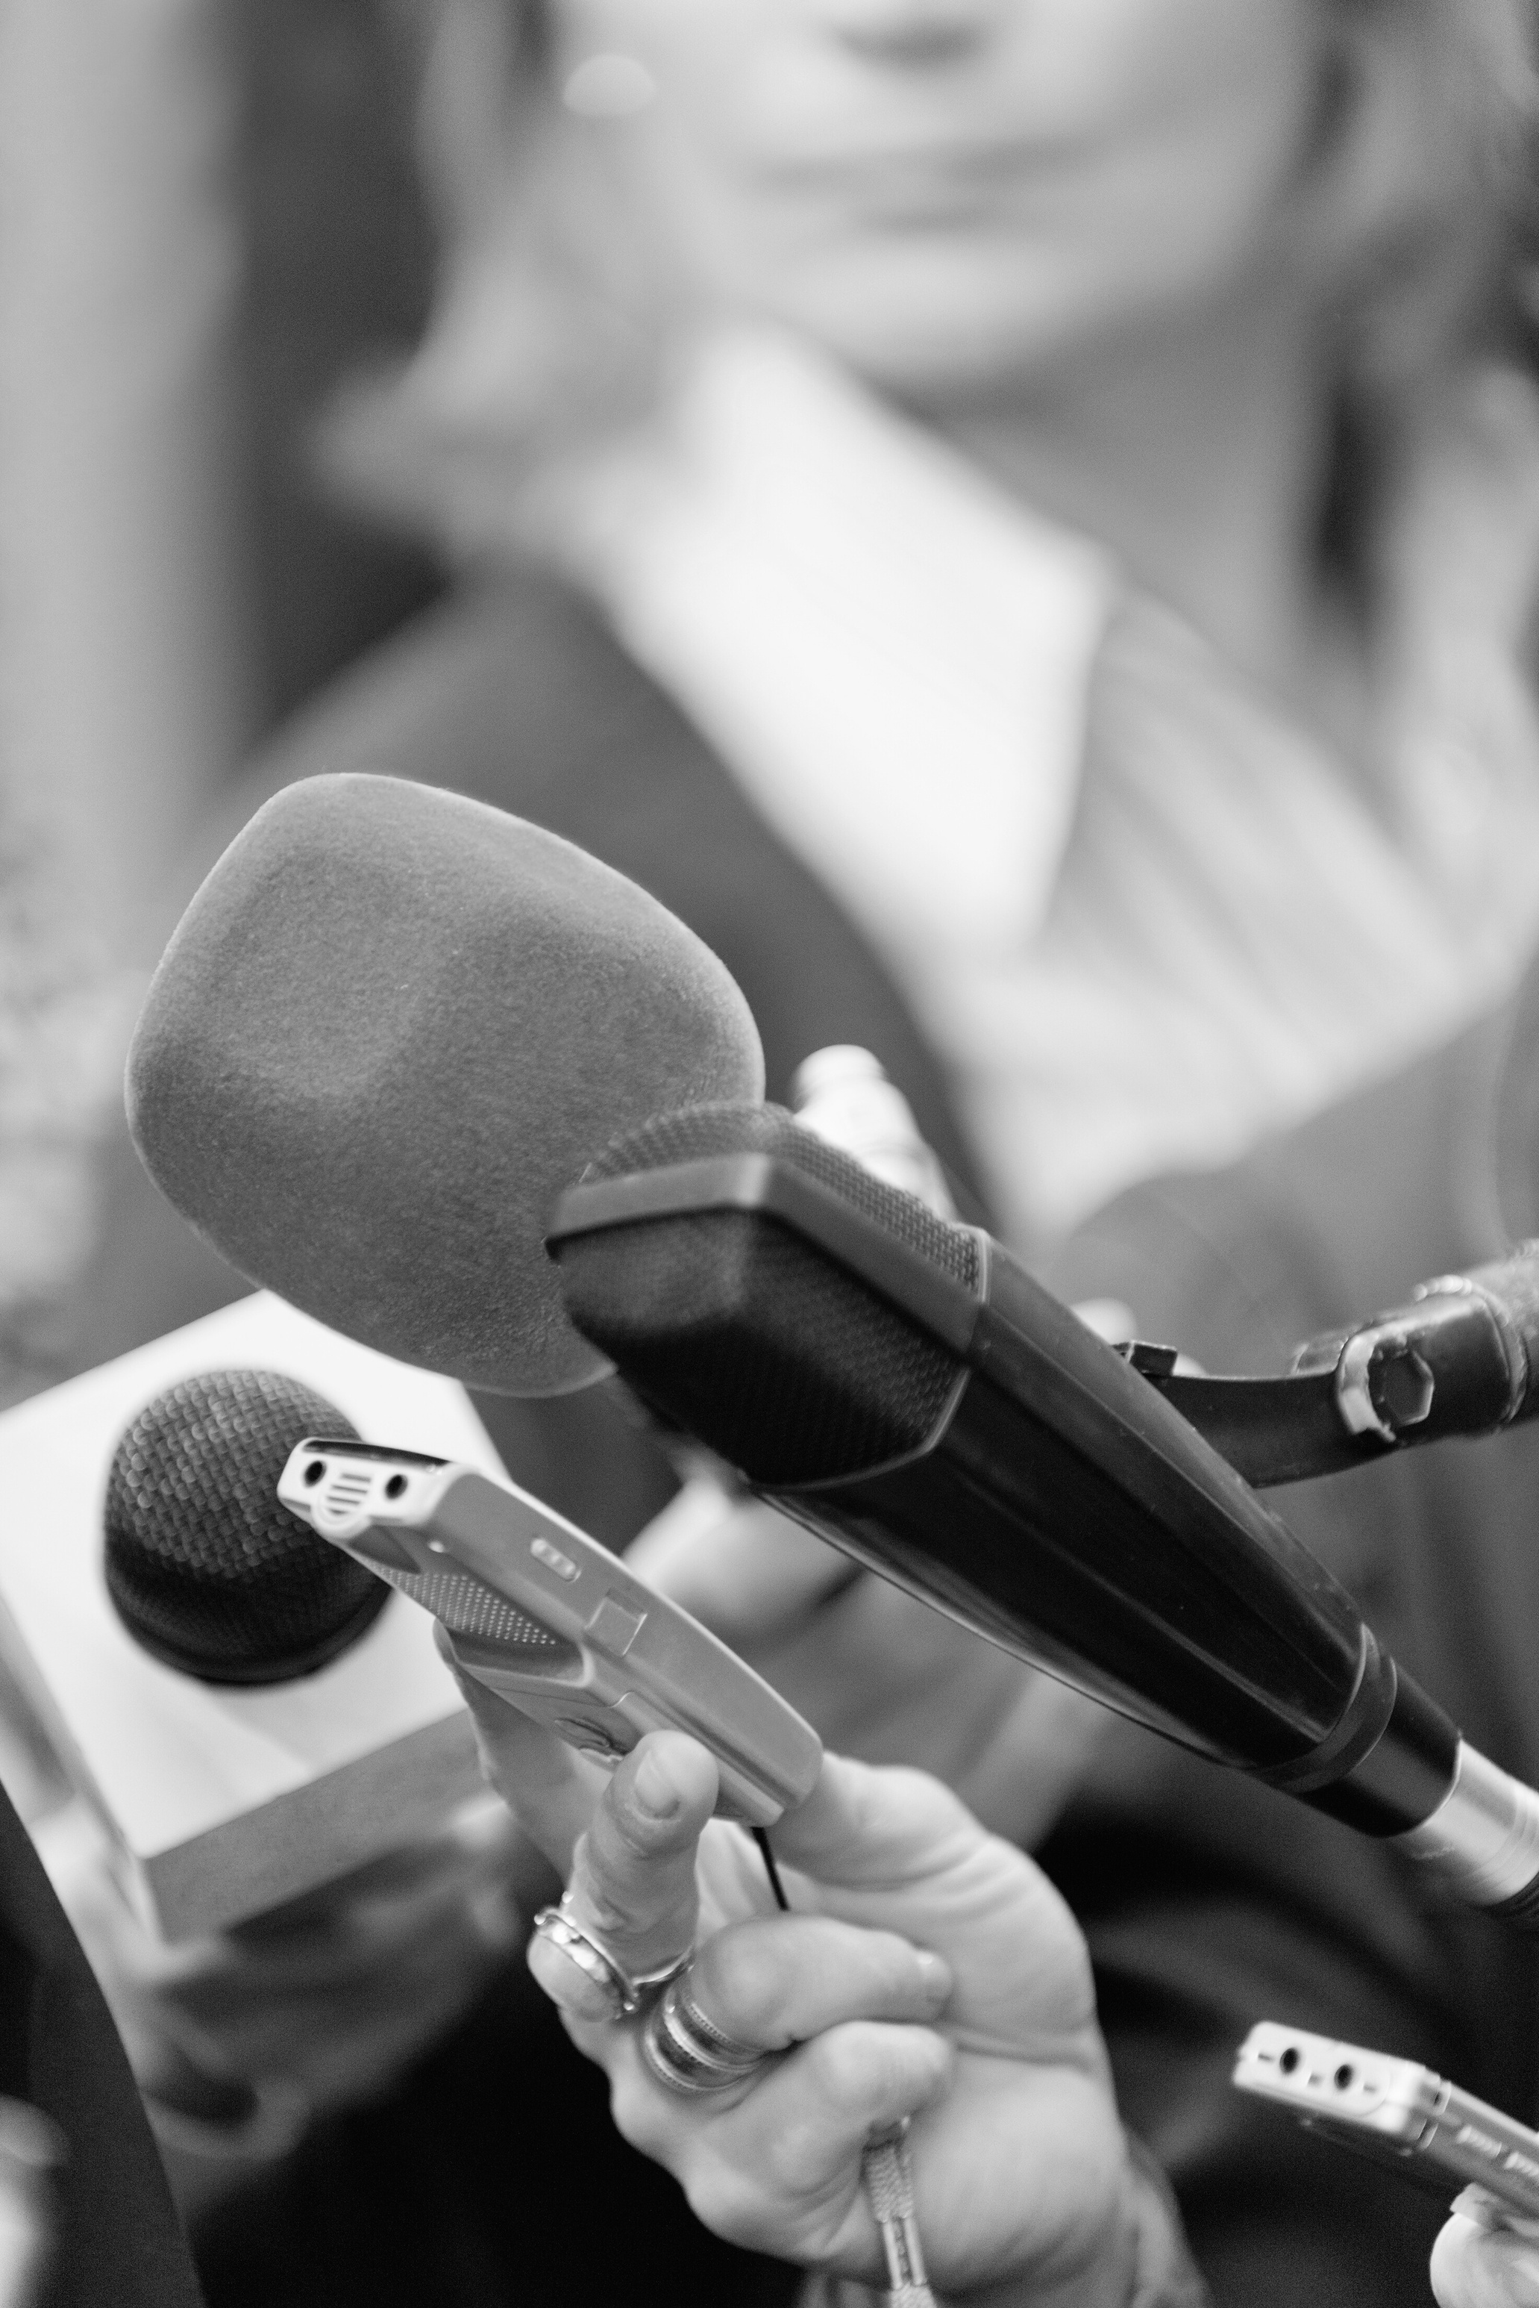

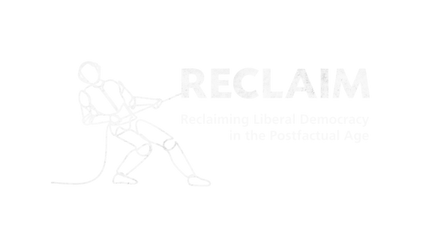

RECLAIM Toolkit for Media Literacy
Prepared By :
Ricardo Castellini da Silva

Slide 2
SESSION 2
“Understanding Misinformation through Media Literacy”

Slide 3
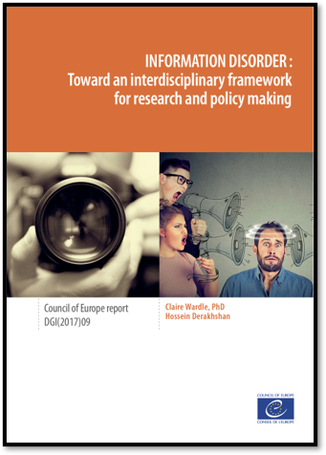
Definitions
Information Disorder​
Information disorder refers to the ecosystem polluted with false or misleading content, which disrupts healthy information environments and undermines public trust in media.​

Slide 4

Definitions
Disinformation: Information that is false and deliberately created to harm a person, social group, organisation or country.​
​
Misinformation: Information that is false but not created with the intention of causing harm.​
​
Mal-information: Information that is based on reality, used to inflict harm on a person, social group, organisation or country.
Source: A Handbook for Journalism Education and Training (UNESCO, 2018)​

Slide 5
Definitions
Populism​
According to Cas Mudde, author of Populism: A Very Short Introduction, in political science populism is the idea that a given society is separated into two groups in constant conflict with each another - "the pure people" and "the corrupt elite”.​
The populist leader usually claims to represent the ‘will of the people’, and stands in opposition to the system current system (or deep state). He uses this binary approach to politics where you are either on the good side or the bad side.

Slide 6
Definitions
Post-truth politics​
Oxford Dictionaries declared post-truth as its international word of the year in 2016.
The expression refers to a political culture where objective facts are less influential in shaping public opinion than appeals to emotion and personal belief. In this kind of environment, rational arguments become less effective, as individuals may stick to their beliefs despite contradictory evidence.

Slide 7
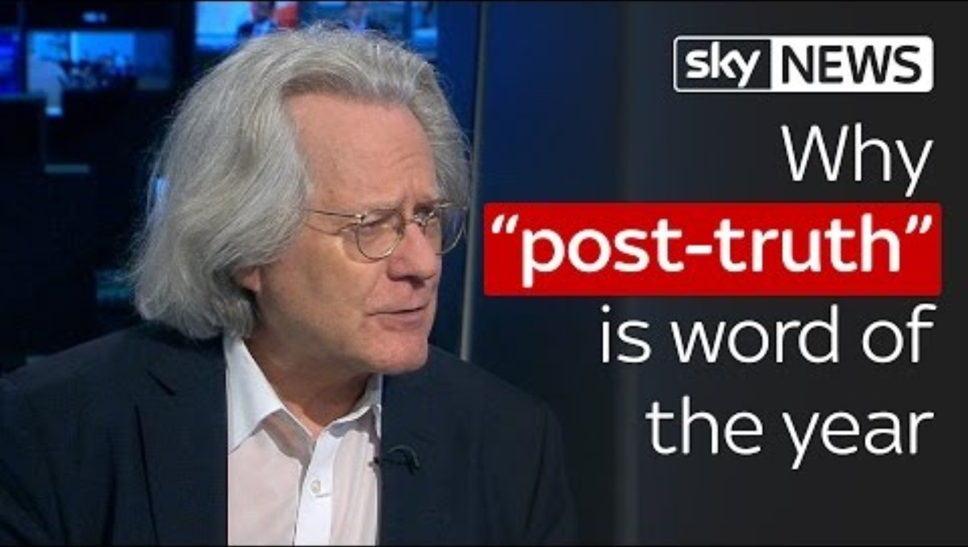
Definitions
Why "post-truth" is word of the year 2016
https://www.youtube.com/watch?v=sCRI -K4VWGc

Slide 8
Practical Activity
Discuss the following statement in your groups:​
Before the internet, access to information was largely controlled by a few powerful institutions, such as governments, major media organizations, academic institutions, and publishing houses. Traditional gatekeepers, such as journalists, editors, and media conglomerates, decided what information was disseminated to the public. This centralised control meant that most people relied on newspapers, television, radio, and books for information, often with limited ability to verify or challenge what they were told.​
​
The internet changed this dynamic by democratising content production and access to information. It enabled individuals to publish and share content without traditional gatekeepers, leading to greater diversity in perspectives and sources. This means less control, more freedom, and easier access to information and knowledge.

Slide 9
Practical Activity
Use the following questions as guidelines for the discussion:​
​How has the internet changed the way we access and trust information?​
​
Has the internet's democratisation of information affected power dynamics in society?​
​
What are the trade-offs between traditional media gatekeeping and today's open information environment?​
​
Has this shift affected people’s ability to distinguish between reliable and unreliable information?​
​
Have journalists become more or less important to information integrity?​
​
Is “greater diversity in perspectives and sources” good for society?

Slide 10
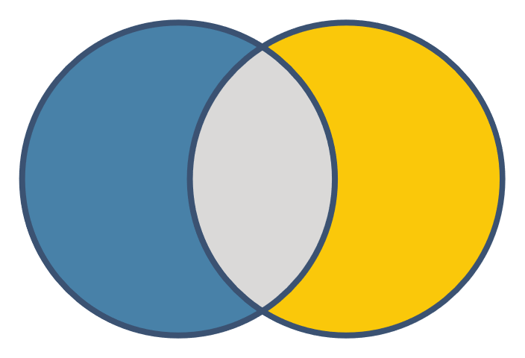
Media & Information Literacy​
​Information literacy is the ability to recognise when information is needed and to locate, evaluate and effectively use the needed information.
(American Library Association 1989). ​
Media
Literacy
Information
Literacy

Slide 11
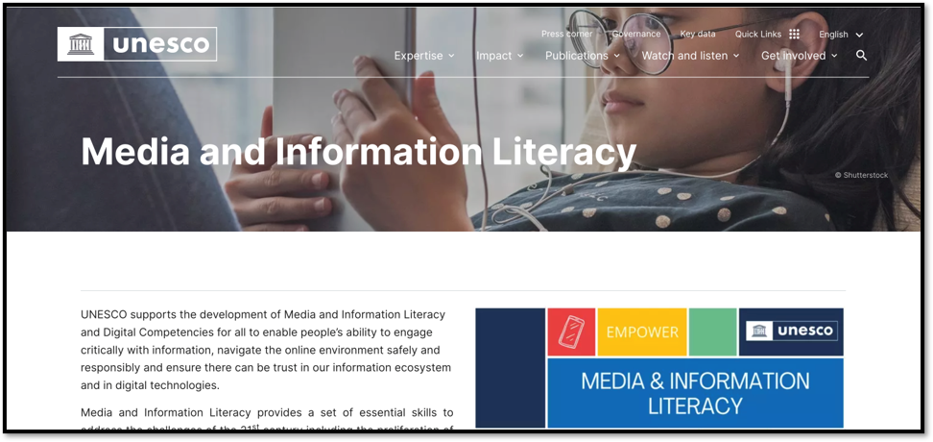
Media & Information Literacy​

Slide 12
Media & Information Literacy​
Media Literacy​
Focus on analysing and creating media messages​
Understanding media formats, techniques, and influence​
Evaluating purpose, authorship, and production elements​
Active engagement with media as both consumer and creator
Media
Literacy
Information
Literacy
Information Literacy
Focus on finding, evaluating, and using information effectively​
Research skills and source evaluation​
Understanding information ecosystems and organization​
Ethical use and attribution of information

Slide 13
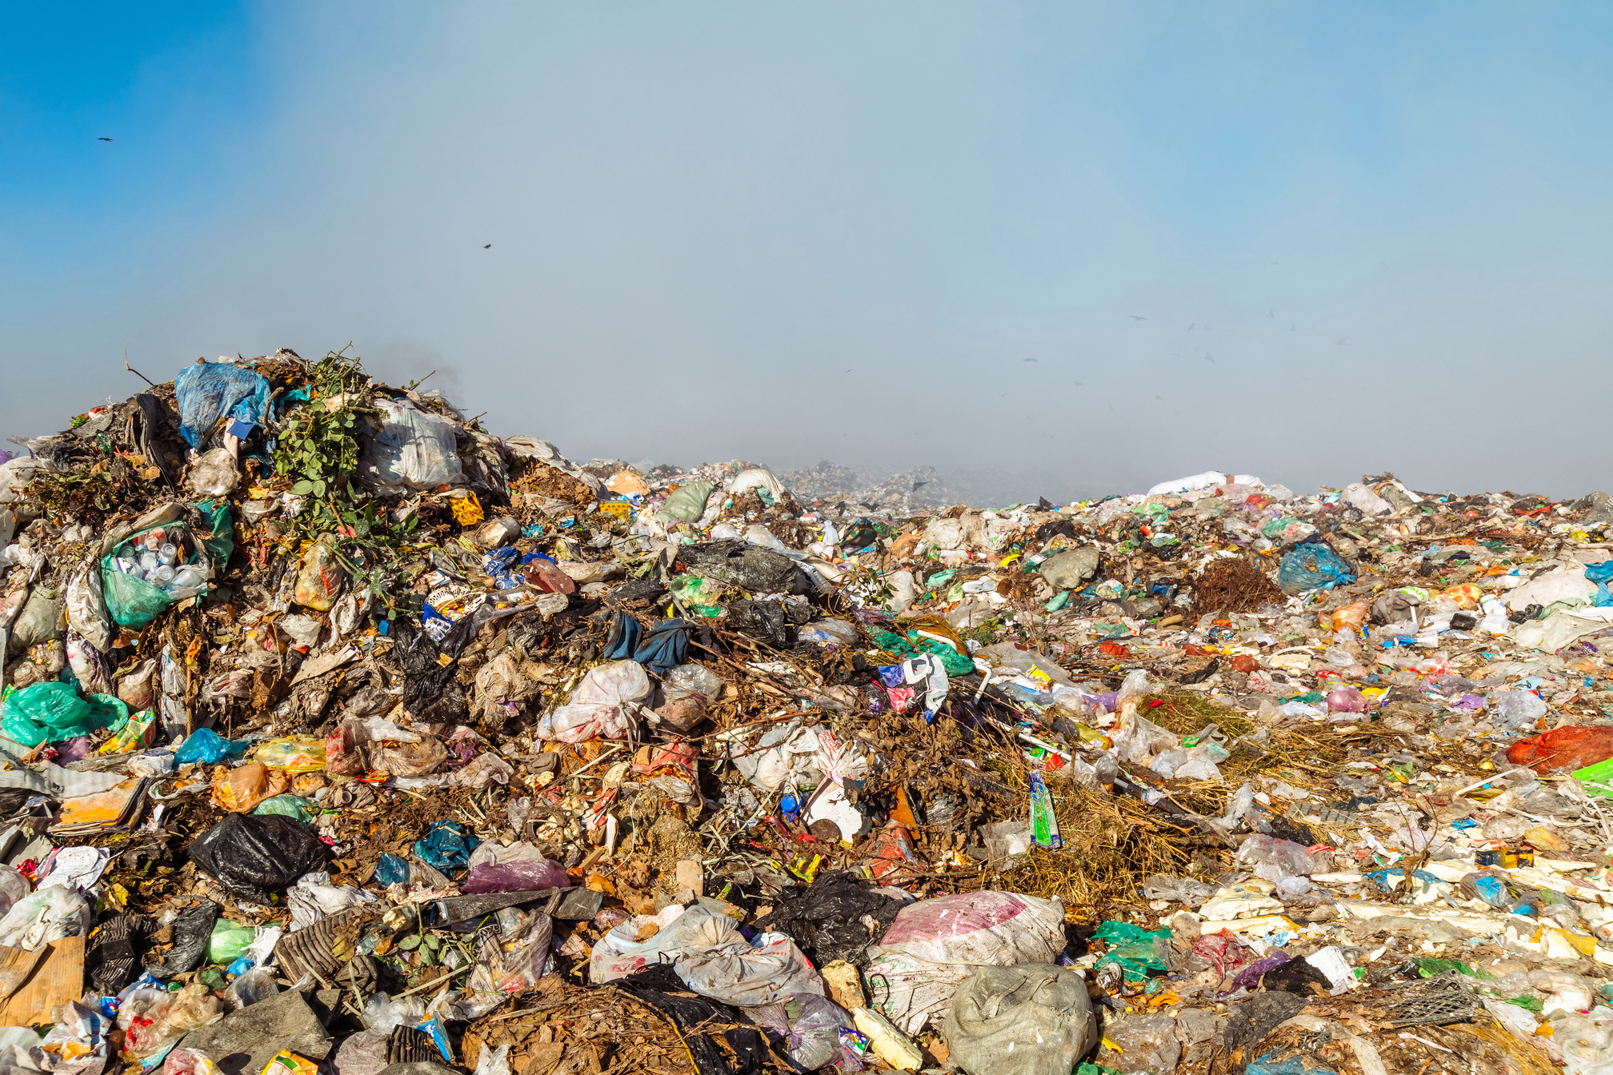
Media & Information Literacy​
Information Disorder
The information environment is polluted.​

Slide 14
Information Manipulation
Fabricated Content​
Completely false content created from scratch​
No basis in reality​
Created specifically to deceive​
Example: a deepfake video of a public figure making a false statement they never actually said

Slide 15
Information Manipulation
Imposter Content​
Impersonating genuine sources​
Misusing real brands/names​
False attribution​
Example: a fake X account mimicking a well-known journalist to spread false information

Slide 16
Information Manipulation
Manipulated/Doctored Content​
Genuine information altered to deceive​
Digital manipulation of photos/videos​
Doctored documents​
Example: a doctored image of a protest where signs are digitally changed to display false messages

Slide 17
Information Manipulation
False Context​
Genuine content shared with false contextual information​
Real images/videos repurposed to illustrate different events​
Example: a photo from a past natural disaster is shared as evidence of a recent event to incite panic.

Slide 18
Information Manipulation
Misleading Content​
Information used to frame an issue or individual in a misleading way​
Cherry-picked facts​
Sensationalist headlines ("clickbait")​
Example: a headline claims that a politician supports a controversial policy when, in reality, their stance is more nuanced.

Slide 19
Information Manipulation
Satire / Parody​
Content created for humorous purposes but potentially mistaken as real​
Can unintentionally mislead when shared out of context​
Example: a satirical website like The Onion or The Waterford Whispers publishes an exaggerated story, but some people believe it to be true.

Slide 20
Information Manipulation
Conspiracy Theories​
Build elaborate explanations that connect unrelated events into patterns suggesting secret coordinated actions by powerful groups​
Reject official explanations as cover-ups, treatingabsence of evidence as evidence of conspiracy​
Are self-sealing—counterevidence is interpreted as further proof of the conspiracy's depth and reach​
Example: QAnon conspiracy theory (2017-present)

Slide 21
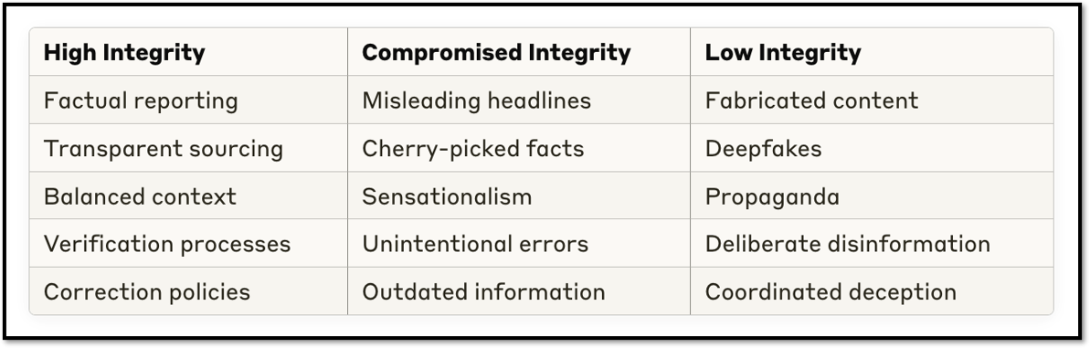
Information Integrity Spectrum

Slide 22
Information Manipulation
It is important to break this dichotomy between fake news and the media. Fighting misinformation is not simply about teaching people about what is real and what is fake. It is actually about being inquisitive about and resilient to all media forms. ​
​
Fake News vs Media Studies: Travels in a False Binary (2019). By Julian McDougall

Slide 23
How Not to Solve the Problem
The problem of misinformation requires a quick and immediate solution;​
Misinformation is still largely (and incorrectly) seen as a digital and technical issue;​
For digital and technical problems, digital and technical solutions.

Slide 24
Technical Solutions
Fact-checking websites, such as Snopes​
Online search tools​
Content verification tools

Slide 25
Technical Solutions
Verification and fact-checking are very important tools, but they are unfeasible for the every day digital media consumption;​
​
We need to develop healthy habits based on a critical approach to Media Studies;​
​
Key concepts: representation, meaning-making, ideology, audience, narrative.

Slide 26
Threats to Information Integrity
Technological Factors: ​
AI-generated content​
Filter bubbles and algorithmic influence​
Easy content manipulation tools​
​
Economic Factors: ​
Attention economy and clickbait incentives​
Decline of traditional journalism business models​
​
Social/Political Factors: ​
Weaponisation of information​
Polarisation and tribalism​
Erosion of trust in institutions

Slide 27
MIL Knowledge and Skills
What are some of the basic knowledge and skills needed to tackle to the disinformation problem? ​

Slide 28
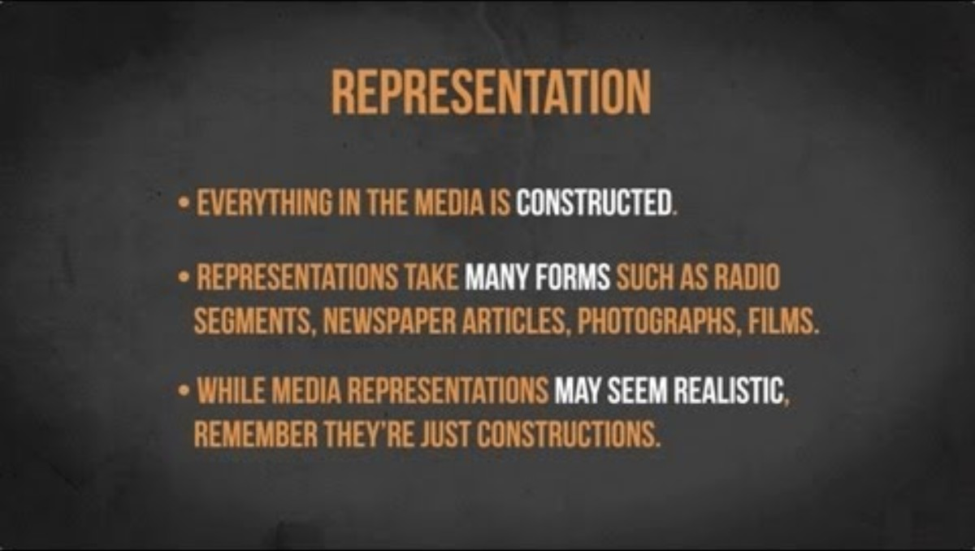
MIL Knowledge and Skills
Media Representation | Media in Minutes | Episode 7​
https://www.youtube.com/watch?v=fOecpti7Qf8

Slide 29
MIL Knowledge and Skills​
Representation​
How various ideas, concepts, experiences, groups, individuals, identities, and cultures are depicted, portrayed, or shown in different media forms: tv, film, news, advertising & online content. ​
​
Representation plays a significant role in shaping how we see the world around us.​
​
ALL MEDIA MESSAGES ARE CONSTRUCTED

Slide 30
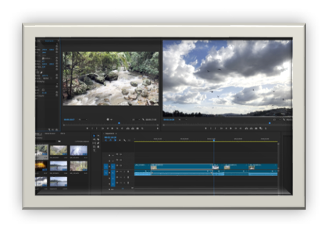
MIL Knowledge and Skills​
Editing​
​There are many different ways of telling the same story…​

Slide 31
MIL Knowledge and Skills​
Media Production​
Practical activities involving the use of media offer a very engaging, creative and effective way of learning about the media
(Buckingham, 2003; Burn and Durran, 2007; Potter and McDougall,2017).​

Slide 32
MIL Knowledge and Skills​
Critical Analysis Through Practice​
Production experiences enhance people’s ability to analyse different media texts more critically​
​
Creating media helps people recognise editing techniques and conventions used in professional media ​
​
Learners develop a more sophisticated understanding of how media can influence audiences

Slide 33
MIL Knowledge and Skills​
Content / Source evaluation​
Lateral Reading is a strategy used by fact-checkers to verify information by reading across multiple sources instead of relying ona single one.​
​
Who owns or sponsors the platform where the original content was published? ​
What do other authoritative sources have to say about the source, the author or the content published? ​
Is the content supported by credible experts or institutions in the field? ​
Are reliable news sources reporting on the same topic? ​
Has the information been fact-checked by reliable platforms? ​
Does what you find in other sources support the original content?

Slide 34
MIL Knowledge and Skills​
The work of content creators​
How can you know if a news source is reliable? ​
​
Using lateral reading to learn more about the news source. Use a search engine to check what other sources say about the publication. For example, checking if the source has a record of publishing false or misleading content; if it is owned or funded by unreliable people, groups or governments; or if it is a satirical publication.

Slide 35
MIL Knowledge and Skills​
The work of content creators​
How can you know if a news source is reliable? ​
​
Assessing the news coverage and different sections of the publication, going through different articles and news stories to check their quality and standards. Reputable sources will not only provide commentary and opinion about current affairs, for example. They will invest in professional journalists who will provide original reporting. ​

Slide 36
MIL Knowledge and Skills​
The work of content creators​
How can you know if a news source is reliable? ​
​
Checking if the source adheres to journalistic standards, such as independence (no conflict of interest), fairness (no partiality or bias), accountability (acknowledging and correcting mistakes), balance (checking multiple perspectives), transparency (clear information about ownership, who produces the content etc.), and accuracy(verifying facts before publishing them). ​

Slide 37
MIL Knowledge and Skills​
The work of content creators​
How can you know if a news source is reliable? ​
​
Analysing the language. Reputable news sources will avoid informal language, will rarely contain grammatical or spelling errors, and will not use discriminatory words or expressions. Also, the use of sensational or exaggerated language, especially on headlines to catch people’s attention (the so-called clickbait), should not be expected in respected news sources. ​

Slide 38
MIL Knowledge and Skills​
Looking inside ourselves​
The consumption of media content is not purely rational. It involves emotion, desire, illusion, imagination etc. We all have some psychological traits that get in the way of amore objective and rational analysis.​

Slide 39
Critical Approach
Take a critical, but not a cynical, approach to engagement with all media, including professional journalism, ‘mainstream media’ more broadly, and social media.​
​
Think beyond the neutral set of skills for citizens to address misinformation.​
​
Move beyond a false binary between ‘fake news’ and mainstream media. It is important to find common ground between the need for professional journalism in a democracy, regulation of the web and critical analysis of mainstream media.​
​
Establish priorities and create healthy media habits, as we cannot check every piece of information we come across.​
​
Understand that media is all about representation of reality.

Slide 40
About RECLAIM
RECLAIM (Reclaiming Liberal Democracy in the Post-Factual Age) is a Horizon Europe project on Reclaiming Liberal Democracy in a Post-Truth era. In recent years there has been a rise in what the experts call “post truth politics”, which manipulates facts and emotions. The project tries to understand how this phenomenon is affecting the future of democracy in Europe, and more importantly, what we can do about it.
About TEPSA
The Trans European Policy Studies Association (TEPSA) was established in 1974 as the first transnational research network in the field of EU affairs. It comprises leading research institutes throughout Europe, with an office in Brussels. Its aim is to provide high-quality research on European integration to stimulate discussion on policies and political options for Europe. This is achieved by the interaction between the European and national institutions as well as the academic and research community. TEPSA is active on a wide range of research topics, focusing on differentiated integration, the EU's external relations, democratic participation and citizens' engagement.

