Slide 1
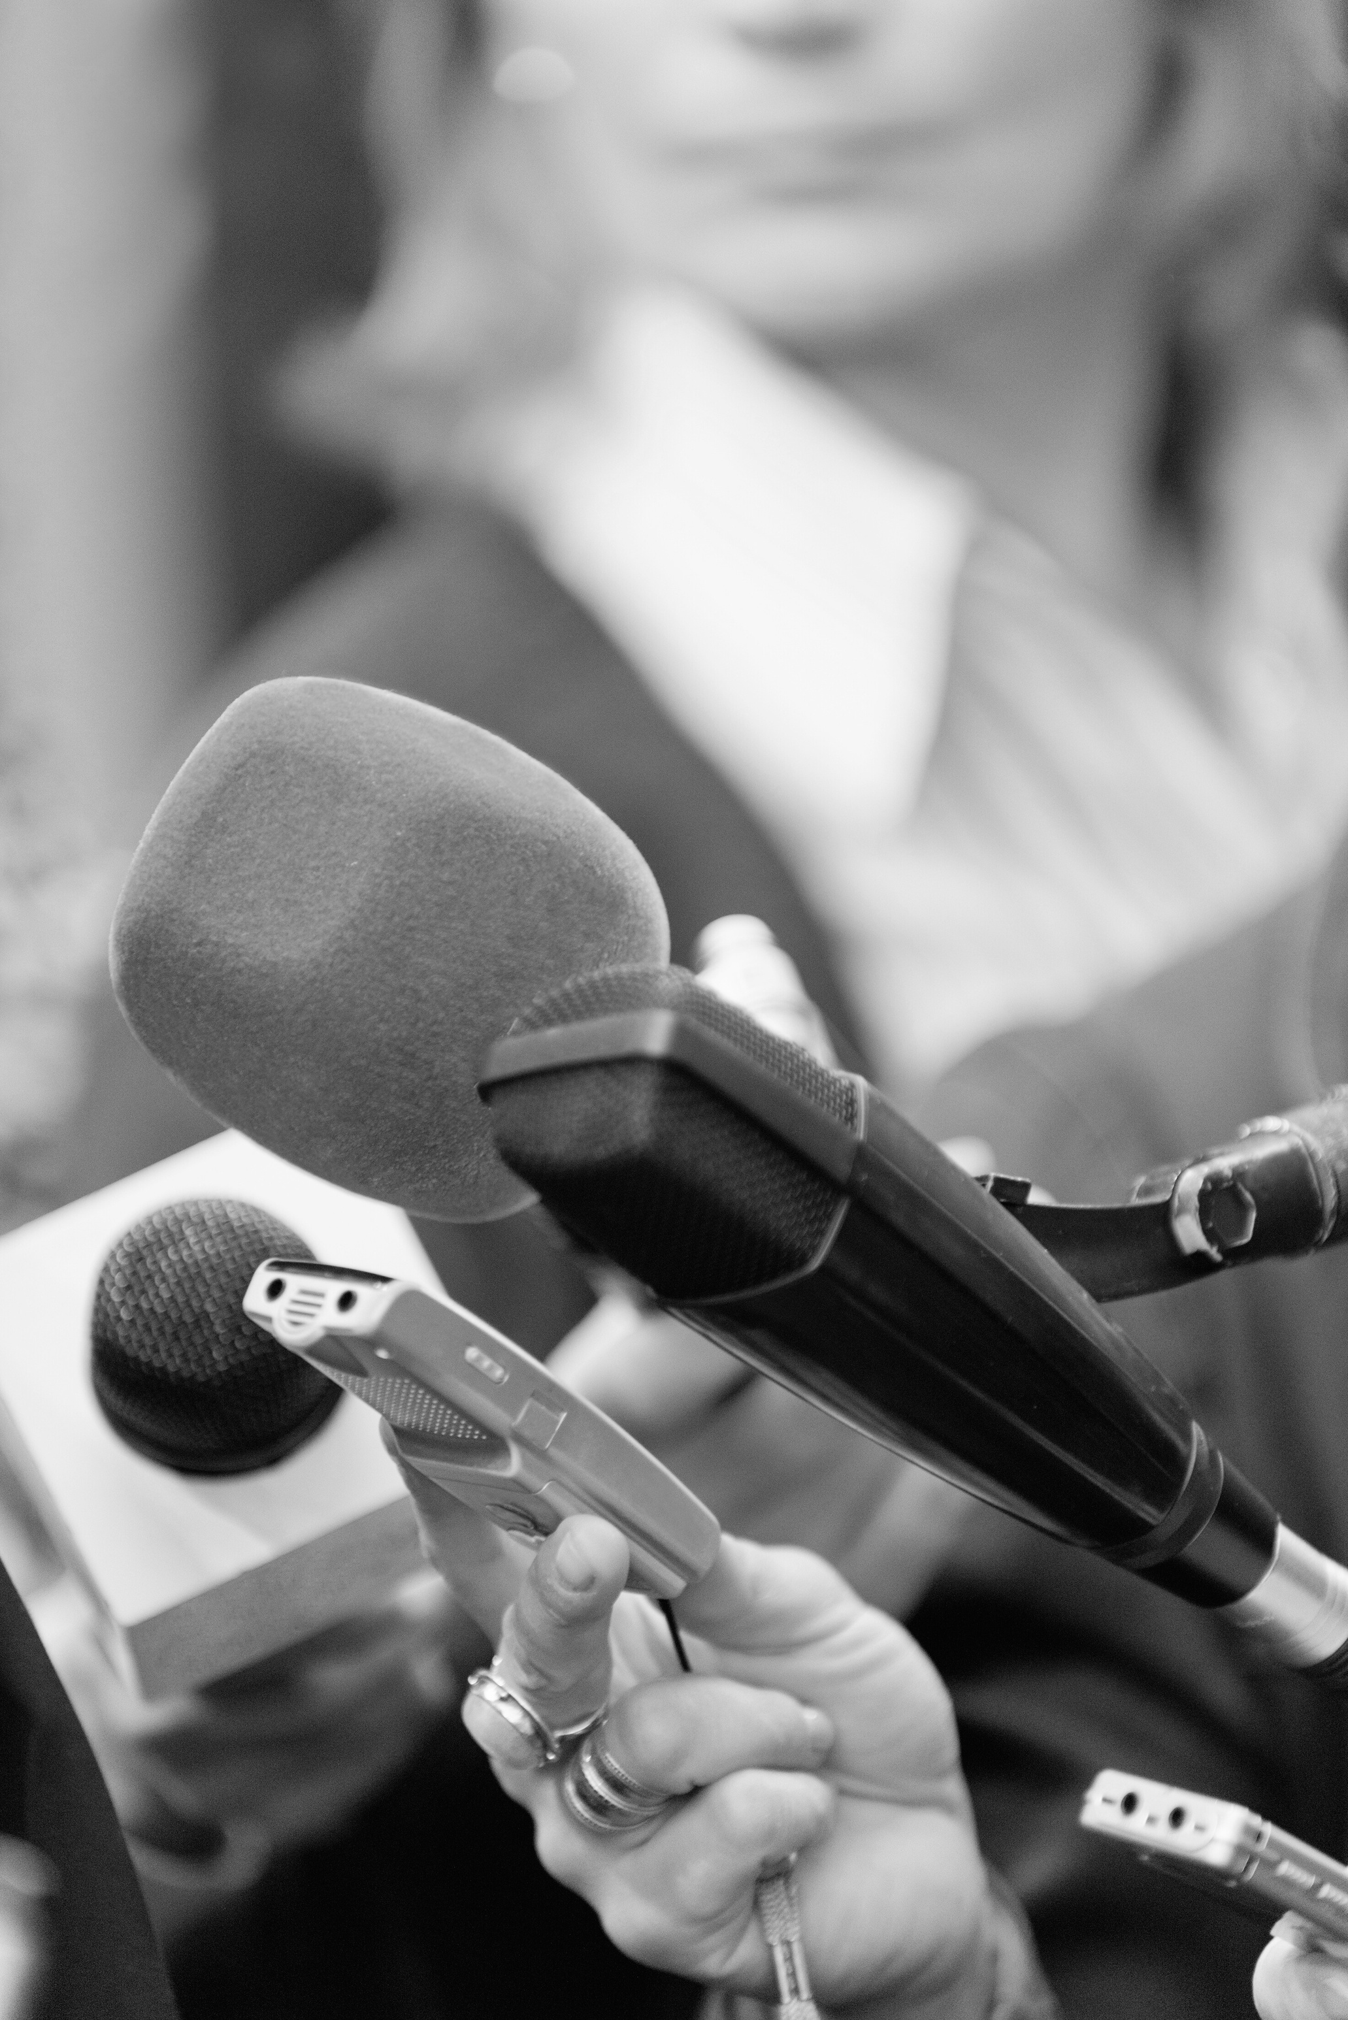

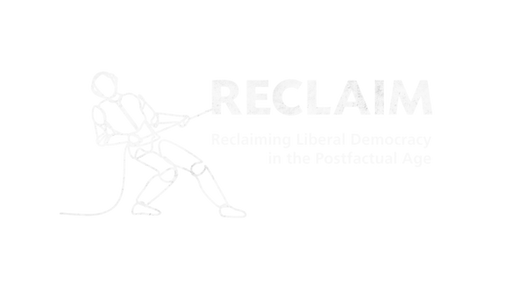

RECLAIM Toolkit for Media Literacy
Prepared By :
Ricardo Castellini da Silva

Slide 2
SESSION 1
“What is Media Literacy for?”

Slide 3
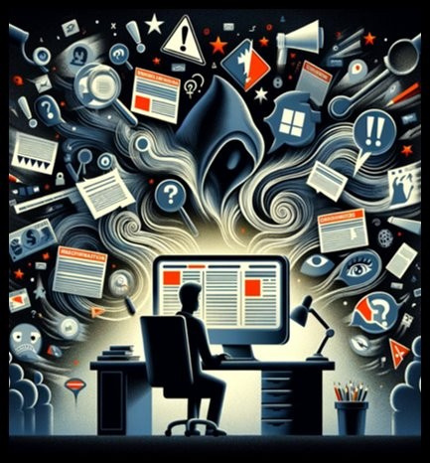
What is Media Literacy?
DEFINITIONS

Slide 4
What is Media Literacy?
Media literacy is the ability toaccess, analyse, evaluate, andproduce media in a variety of forms. ​
​
(Aufderheide, 1993)

Slide 5
What is Media Literacy?
Media Literacy is the ability to access, analyse, evaluate, create and act using all forms of communication.​
​
(The National Association for Media Literacy Education, 2023)

Slide 6
What is Media Literacy?
“Whatever knowledge and skills one needs to understand and participate in the media ecosystem.”​
​
(Sonia Livingstone, speaking at EDMO conference 2022)

Slide 7
Digital Media Literacy
DML is a subgroup of media literacy that focuses on digital content and platforms, such as websites, apps, social media, messaging platforms, search engines and digital games. ​
​
DML involves “whatever” knowledge and skills you need to participate in an increasingly digitally-mediated world.

Slide 8
Mediated World
Communication
Learning
Consumption
Mobility
Creative Practices
Cultural Engagement
Entertainment
Work
Self-Expression

Slide 9
Focus
In Media Literacy, the focus should not be on technology skills, but on foundational and critical knowledge about media and digital media, so that people can assess and respond to the major challenges that typify their online worlds (e.g., disinformation, manipulation, hate speech, cyberbullying etc.) and the major opportunities (e.g., communication, learning, creativity, cooperation etc.). ​

Slide 10
Celebratory Approach
This is a more individualistic approach that emphasizes the positive aspects and potential benefits of media, emphasising the empowering, communicative, educational, and creative possibilities offered by digital media, and how it can be a force for good. ​
Questions we should ask - How can media literacy practices be used to:​
​
develop people’s literacy and meaning making practices?​
foster people’s creativity?​
help people use their everyday practices and cultural references in meaningful ways?​
promote civic participation and self-expression in digital spaces?​
promote learning opportunities and personal development?

Slide 11
Critical Approach
This is a more contextual (or collective) approach that emphasises a more analytical, reflective andinquiry-based attitude towards media. It encourages individuals to critically evaluate the content, production, and impact of media on society.​
Questions we should ask - How can media literacy practices be used to:​
​
help people become empowered citizens that make well-informed decisions about the content and information they consume?​
analyse media messages and understand how they influence people’s behaviours and attitudes?​
critically discuss power imbalances, biases and stereotypes through the analysis of media representations?​
analyse how media is produced and the economic and political contexts in which it operates?​
discuss the risks in digital spaces, especially in relation to privacy and safety?​
promote the use of digital platforms as tools for social change and civic participation?​

Slide 12
Media Literacy in Practice
What is media literacy for?​
​
What are the uses of media literacy?

Slide 13
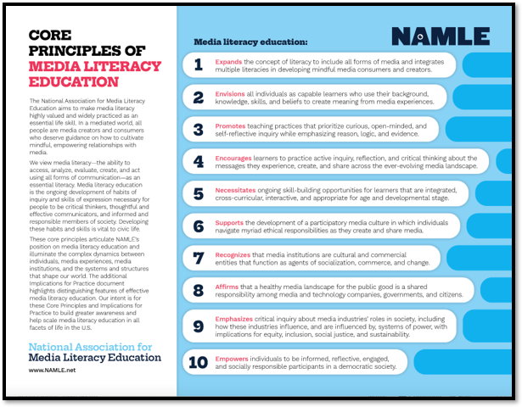
Media Literacy in Practice
https://namle.net/resources/core-principles/​

Slide 14
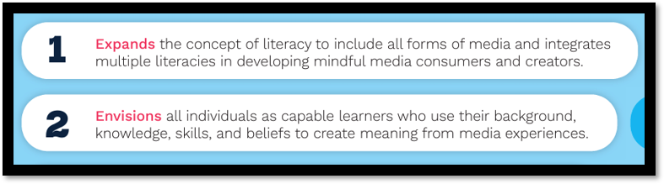
Media Literacy in Practice

Slide 15
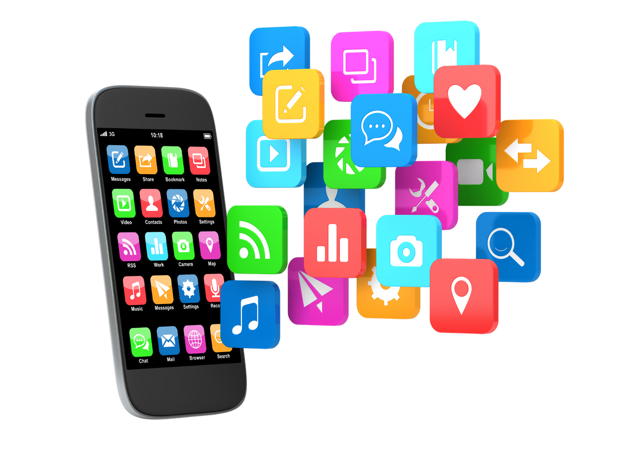

Media Literacy in Practice
Literacy in the context of mediated reality​
Meaning Making Practices

Slide 16
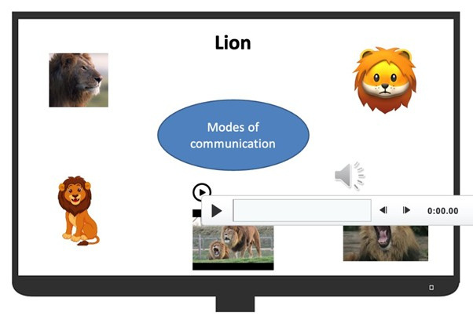
Media Literacy in Practice

Slide 17
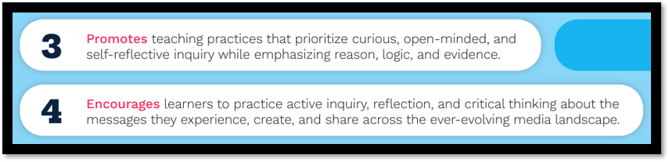
Media Literacy in Practice

Slide 18
Media Literacy in Practice
Analysis of media content / information​
​
Content manipulation / disinformation​
​
Conspiracy theories

Slide 19
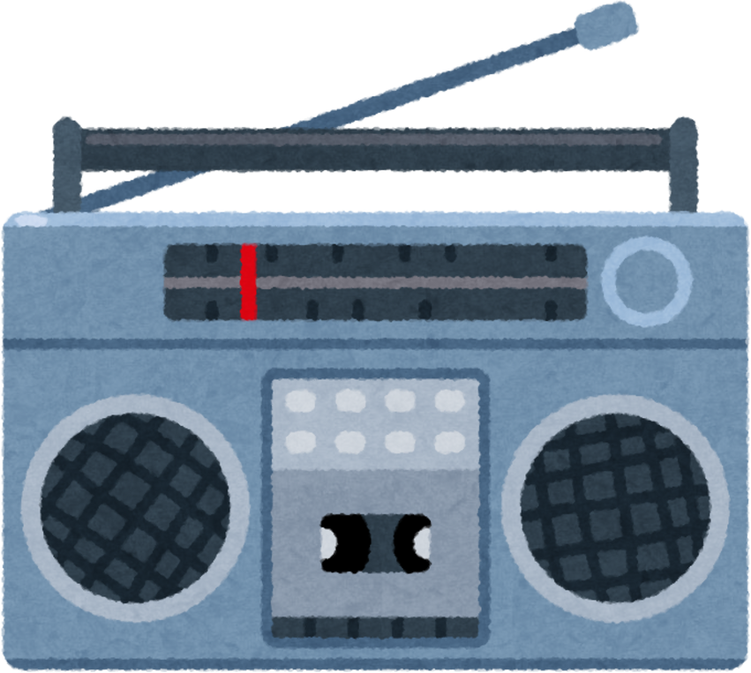


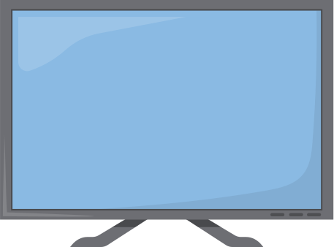
Media Literacy in Practice
Sources: what is a reliable source of information?​
​
Messages: all media messages are constructed, so they can be deconstructed.

Slide 20
Media Literacy in Practice
Disinformation and Conspiracy Theories​
QAnon​
Flat earth​
Climate change is a hoax​
Great replacement theory​
COVID19 vaccines are used to control people’s minds

Slide 21
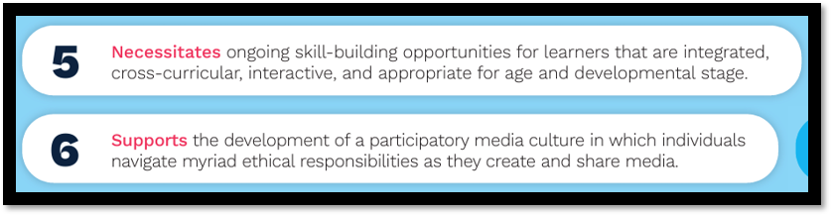
Media Literacy in Practice

Slide 22
Media Literacy in Practice
Continuous tech and pedagogical innovation​
​
Cultural engagement (pop culture practices)​
​
Safe and responsible participation in digital media spaces

Slide 23
Media Literacy in Practice
Everyone is talking about AI and how it impacts our experience with digital media. This means there are new knowledge and skills to be learned.​
Issues and challenges to consider:
Privacy
Surveillance
Copyright
Ownership
Misrepresentation
Algorithmic bias
Mis/disinformation

Slide 24

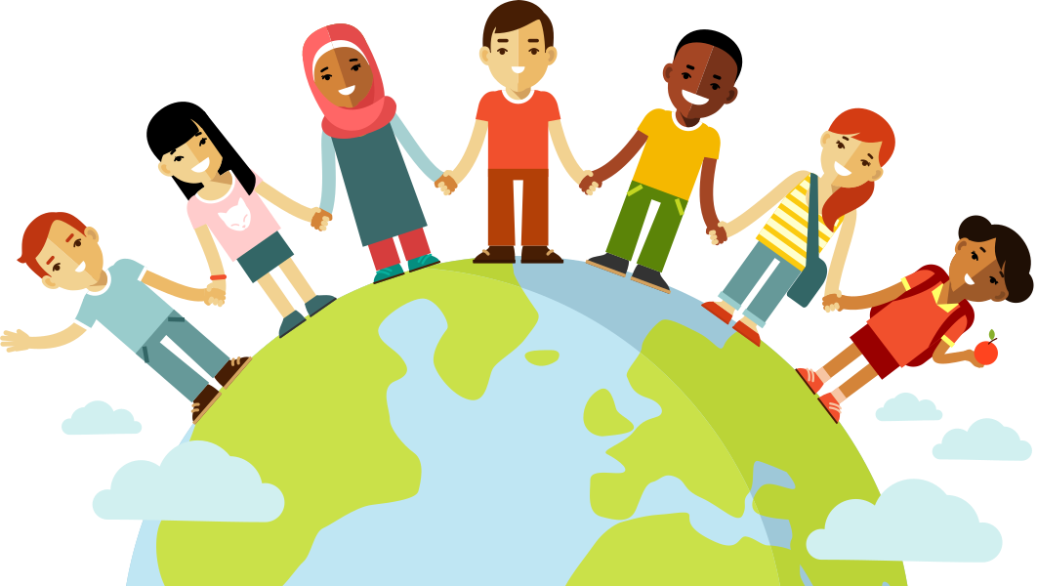

Media Literacy in Practice
Acknowledge the importance of people’s everyday experiences with digital media andhow they participate in the digital culture environment.​
Cultural expression​
Diversity​
Inclusion​

Slide 25
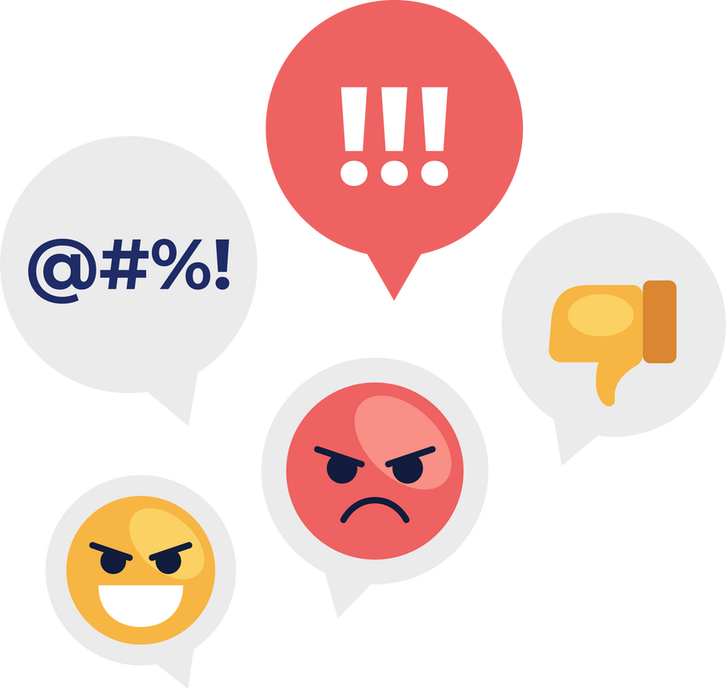
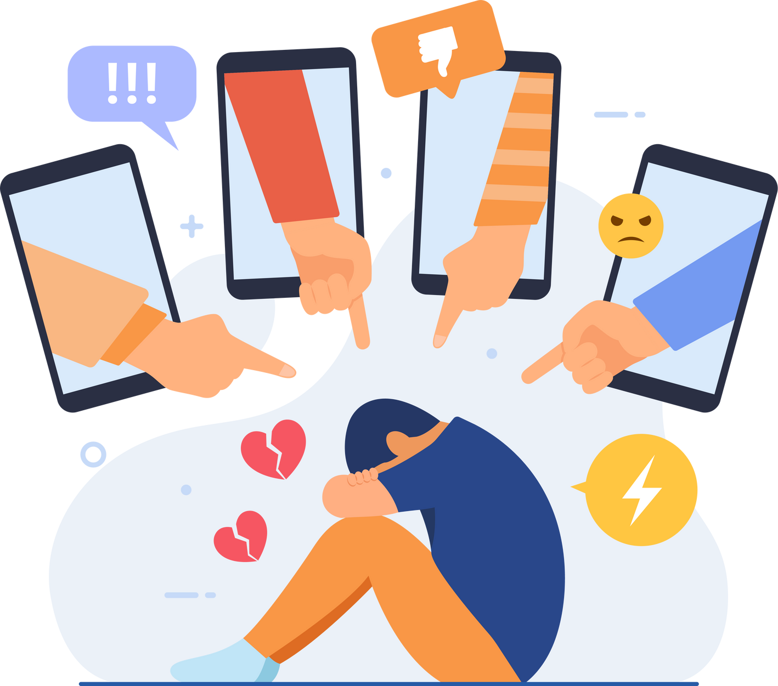
Media Literacy in Practice
Acknowledge the threats and challenges in digital spaces, and understand ourresponsibility as digital citizens. ​
Hate Speech​
Cyberbullying​

Slide 26
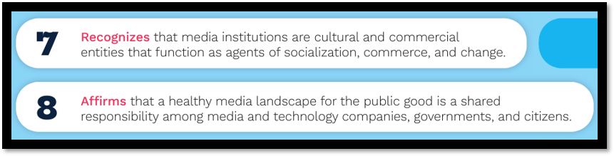
Media Literacy in Practice

Slide 27
Media Literacy in Practice
Business model and cultural forms​
​
Data safety and privacy​
​
Responsibilities and accountabilities (public consultations and regulation)

Slide 28
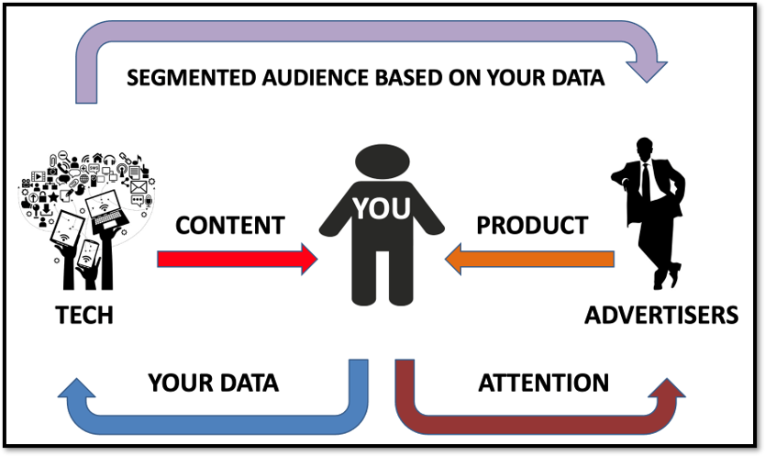
Media Literacy in Practice

Slide 29
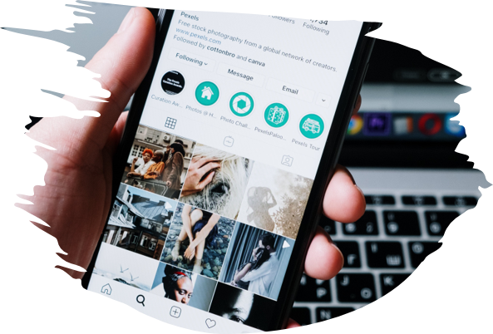
Media Literacy in Practice
Cultural ​Forms

Slide 30
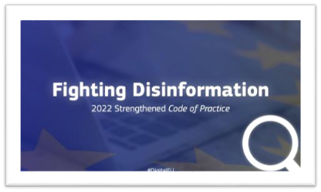
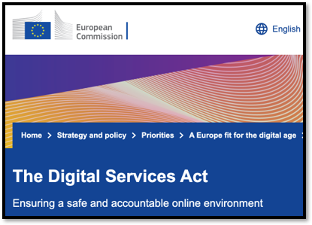

Media Literacy in Practice
Regulation​

Slide 31
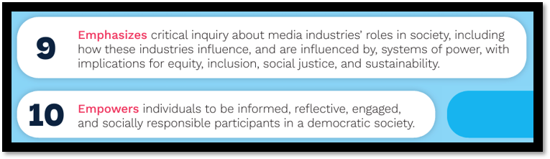
Media Literacy in Practice

Slide 32
Media Literacy in Practice
Media and Tech Industries​
​
Activism and citizenship

Slide 33
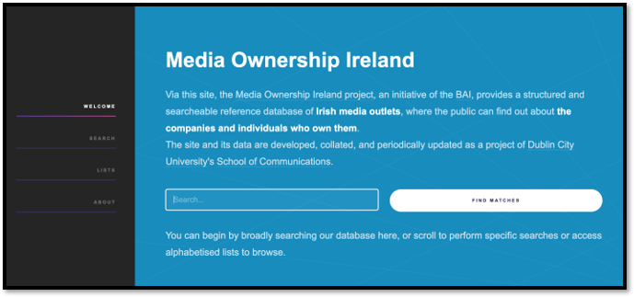
Media Literacy in Practice
Media Ownership​

Slide 34
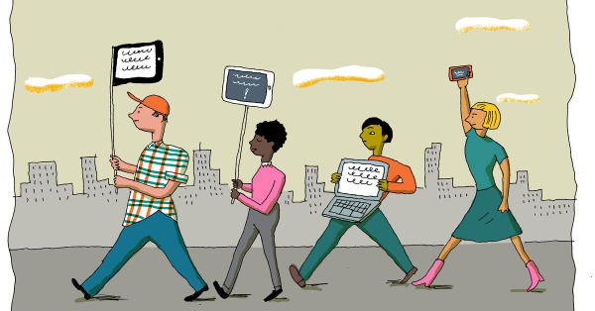
Media Literacy in Practice

Slide 35
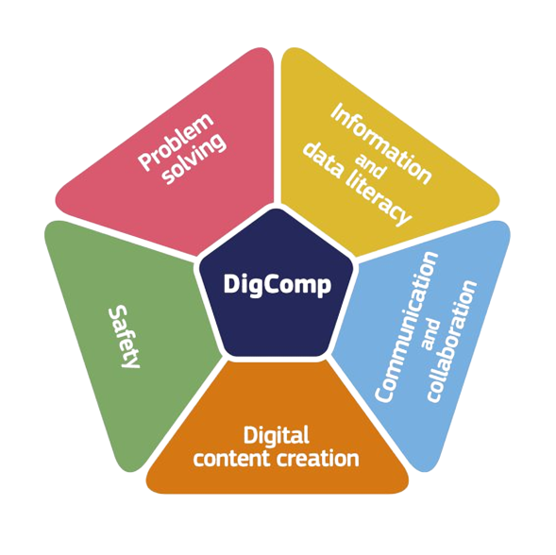
Other Frameworks​
Digital Competence Framework for Citizens (DigComp)​

Slide 36
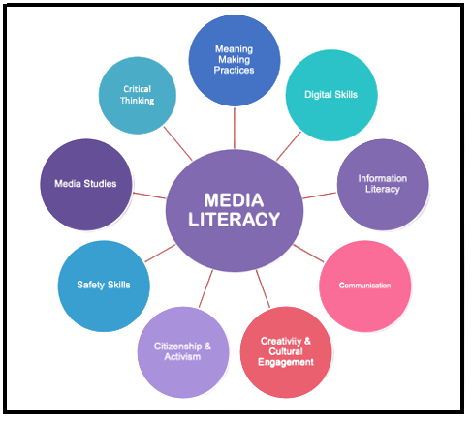
Media Literacy
Knowledge, Skills and Attitudes​

Slide 37
Media Literacy
Topics
Mis/disinformation
Artificial Intelligence
Media representation
Social media
Algorithms
Propaganda
Visual literacy
Multimodality
Creative practices
News media/journalism
Advertising and consumerism
Copyright and fair use
Critical thinking
Media and personal bias
Privacy and data collection
Media ownership and control

Slide 38
Media Literacy
How to evaluate sources of information​
How to analyse media messages
Algorithms and misinformation​
Facts vs Opinion​
Free speech and democracy​
Fact-checking​
Journalism standards to prevent misinformation​
AI and deep fakes
Sub-Topics
MIS/DISINFORMATION

Slide 39
Media Literacy
Media/Communications Studies
Education
Cultural Studies
Digital Technology
Psychology/Neuroscience
Areas of knowledge

Slide 40
Media Literacy
WHAT DOES IT MEAN TO BE A MEDIA LITERATE PERSON?​

Slide 41
About RECLAIM
RECLAIM (Reclaiming Liberal Democracy in the Post-Factual Age) is a Horizon Europe project on Reclaiming Liberal Democracy in a Post-Truth era. In recent years there has been a rise in what the experts call “post truth politics”, which manipulates facts and emotions. The project tries to understand how this phenomenon is affecting the future of democracy in Europe, and more importantly, what we can do about it.
About TEPSA
The Trans European Policy Studies Association (TEPSA) was established in 1974 as the first transnational research network in the field of EU affairs. It comprises leading research institutes throughout Europe, with an office in Brussels. Its aim is to provide high-quality research on European integration to stimulate discussion on policies and political options for Europe. This is achieved by the interaction between the European and national institutions as well as the academic and research community. TEPSA is active on a wide range of research topics, focusing on differentiated integration, the EU's external relations, democratic participation and citizens' engagement.

